Slide 1

EDPS302 – Creating Positive Learning Environments
Models of behaviour management
Lecture 4
Applied Behaviour Analysis and
Cognitive behavioural approaches
August 15, 2017
Ray Handley

Slide 2
EDPS302 – Creating Positive Learning Environments
This week:
Applied behaviour analysis – B.F. Skinner
Functional behaviour analysis
Rational Emotive Behaviour Therapy – Albert Ellis
Talk sense to yourself – Jeff Wragg
Emotional temperature graph

Slide 3





Cognitive behavioural therapy (CBT)
Applied Behaviour Analysis (ABA)
Changes in attitude and thinking create different patterns of behaviour that modify consequences and outcomes
environment
By understanding and modifying the environment new patterns of behaviour can be created.
thinking
actions
2
models of behaviour change

Slide 4
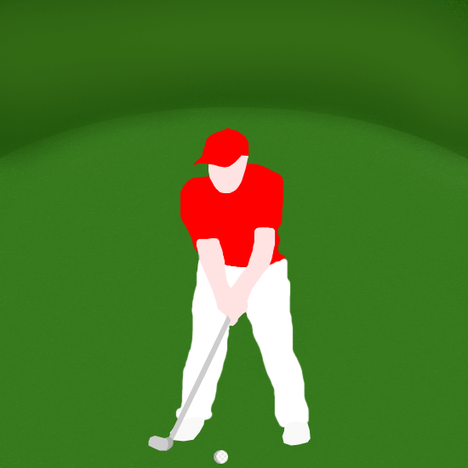

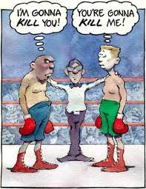
Some examples from sport
Observe, deconstruct, analyse, correct, practice
Thinking, self talk, reconstruct, practice, avoid, plan
Applied Behaviour Analysis
Cognitive Behaviour Therapy

Slide 5

Applied Behaviour Analysis
(Behaviour Modification)
Psychology should be seen as a science, to be studied in a scientific manner.
Skinner's study of behaviour in rats was conducted under carefully controlled laboratory conditions.
features
from: http://www.simplypsychology.pwp.blueyonder.co.uk/operant-conditioning.html

Slide 6
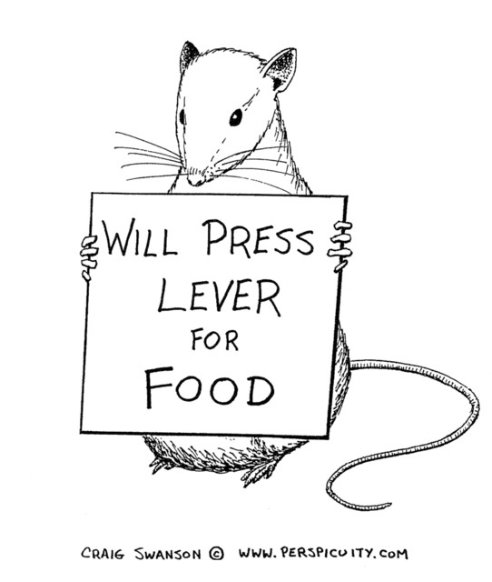
Applied Behaviour Analysis
(Behaviour Modification)
Behaviourism is primarily concerned with observable behaviour, as opposed to internal events like thinking and emotion.
Note that Skinner did not say that the rats learnt to press a lever because they wanted food. He instead concentrated on describing the easily observed behaviour that the rats acquired.
features
from: http://www.simplypsychology.pwp.blueyonder.co.uk/operant-conditioning.html

Slide 7
Applied Behaviour Analysis
(Behaviour Modification)
The major influence on human behaviour is learning from our environment.
In the Skinner study, because food followed a particular behaviour the rats learned to repeat that behaviour, e.g. classical and operant conditioning.
features
from: http://www.simplypsychology.pwp.blueyonder.co.uk/operant-conditioning.html

Slide 8
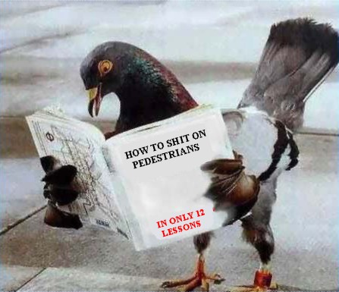
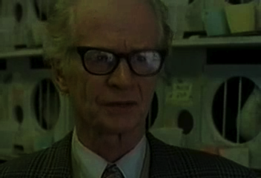

Applied Behaviour Analysis
(Behaviour Modification)
experiments
Can pigeons read?
Skinners Box

Slide 9
Applied Behaviour Analysis
(Behaviour Modification)
There is little difference between the learning that takes place in humans and that in other animals.
Therefore research (e.g. classical conditioning) can be carried out on animals (Pavlov’s dogs) as well as on humans (Little Albert . . . more).
Skinner proposed that the way humans learn behaviour is much the same as the way the rats learned to press a lever.
features
from: http://www.simplypsychology.pwp.blueyonder.co.uk/operant-conditioning.html

Slide 10
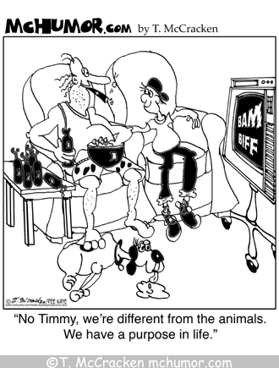
Applied Behaviour Analysis
(Behaviour Modification)
features
‘ There is little difference between the learning that takes place in humans and that in other animals.’

Slide 11
Applied Behaviour Analysis
(Behaviour Modification)
Skinner coined the term operant conditioning; it means changing behaviour by the use of reinforcement which is given after the desired response.
Skinner identified three types of responses or operants that can follow behaviour.
features
from: http://www.simplypsychology.pwp.blueyonder.co.uk/operant-conditioning.html

Slide 12
Applied Behaviour Analysis
(Behaviour Modification)
Neutral operants: responses from the environment that neither increase nor decrease the probability of a behaviour being repeated.
Reinforcers: Responses from the environment that increase the probability of a behaviour being repeated. Reinforcers can be either positive or negative.
Punishers: Responses from the environment that decrease the likelihood of a behaviour being repeated. Punishment weakens behaviour.
features
Before heading out for a day at the beach, you slather on sunscreen in order to avoid getting sunburned.
You leave the house early in order to avoid getting stuck in traffic and being late for class.
from: http://www.simplypsychology.pwp.blueyonder.co.uk/operant-conditioning.html
Notes:
In Negative Reinforcement a particular behavior is strengthened by the consequence of the stopping or avoiding of a negative condition.
e.g. Here are two examples of Negative Reinforcement:
1. A rat is placed in a cage and immediately receives a mild electrical shock on its feet. The shock is a negative condition for the rat. The rat presses a bar and the shock stops. The rat receives another shock, presses the bar again, and again the shock stops. The rat's behavior of pressing the bar is strengthened by the consequence of the stopping of the shock.
2. Driving in heavy traffic is a negative condition for most of us. You leave home earlier than usual one morning, and don't run into heavy traffic. You leave home earlier again the next morning and again you avoid heavy traffic. Your behavior of leaving home earlier is strengthened by the consequence of the avoidance of heavy traffic.

Slide 13
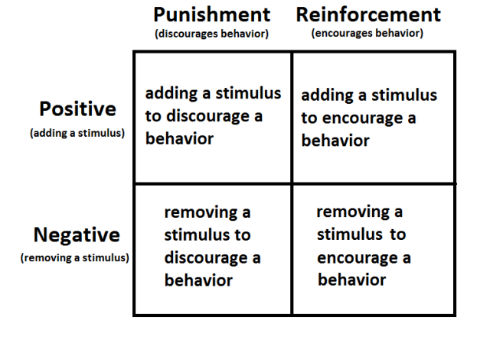
Applied Behaviour Analysis
(Behaviour Modification)
features
Notes:
In Negative Reinforcement a particular behavior is strengthened by the consequence of the stopping or avoiding of a negative condition.
e.g. Here are two examples of Negative Reinforcement:
1. A rat is placed in a cage and immediately receives a mild electrical shock on its feet. The shock is a negative condition for the rat. The rat presses a bar and the shock stops. The rat receives another shock, presses the bar again, and again the shock stops. The rat's behavior of pressing the bar is strengthened by the consequence of the stopping of the shock.
2. Driving in heavy traffic is a negative condition for most of us. You leave home earlier than usual one morning, and don't run into heavy traffic. You leave home earlier again the next morning and again you avoid heavy traffic. Your behavior of leaving home earlier is strengthened by the consequence of the avoidance of heavy traffic.

Slide 14
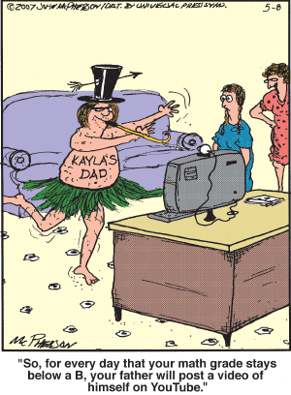
Which quadrant?

Slide 15
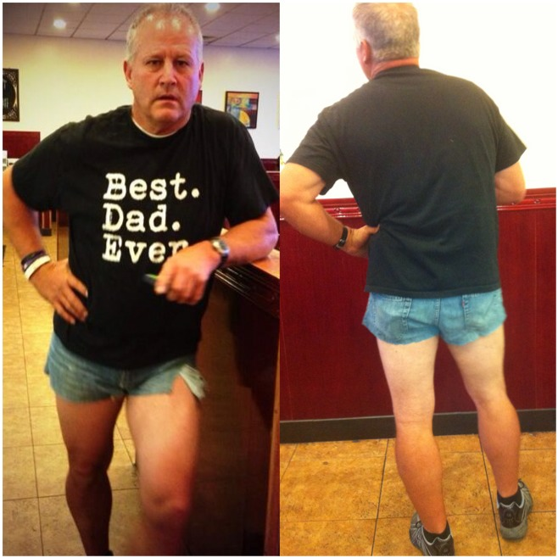
Operant conditioning - Reinforcement
Negative Reinforcement
My mum told me to change my “inappropriate” shorts before we went to dinner.
I said no.
So my dad cut his jeans, and we went to dinner and then mini golf like this.
Daughter of Scott Mackintosh

Slide 16
Applied Behaviour Analysis
(Behaviour Modification)
applications
any classroom using token reinforcements and/or reward/punishment systems
Special Education classrooms
ED/BD units
with students on the Autism spectrum
and . . . .
as the basis for the identification of behaviour patterns (Functional Assessments) and the development of Individual Education Plans (IEPs) across all settings and especially as part of the Positive Behavioural Intervention and Supports (PBIS or PBL)

Slide 17

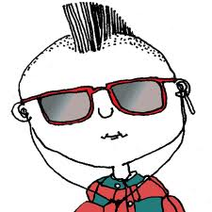
FBA – Form & function
Skill building
The Crisis Development Model
exp
integrated
Staff responses
Environmental
erience
Integration with PBL
Form
All behaviour has a
( used to communicate )
Examples: words, non-verbals, actions
Function
( reason for the behaviour)
Common functions:
to access/obtain
to avoid/escape
to fulfil a sensory need
Functional behavioural assessment
Notes:
Integrated experience is inserted here to introduce an awareness that the behaviour of clients and the actions of staff affect or feedback to each other.

Slide 18
FBA – integration with PBIS
Skill building
The Crisis Development Model
exp
Environmental
integrated
Staff responses
erience
Integration with PBL
Behaviour interventions need to be matched to the function of the behaviour. The more we increase and support positive behaviour the less we will see the challenging behaviour.
Reduce challenging behaviour
Increase & support positive behaviour
Functional behavioural assessment
more . . .
Notes:
Integrated experience is inserted here to introduce an awareness that the behaviour of clients and the actions of staff affect or feedback to each other.

Slide 19
FBA – Designing plan
Skill building
The Crisis Development Model
exp
integrated
Staff responses
Environmental
erience
Functional Behaviour Assessment
STEP 4 – Designing a Behaviour Support & Intervention Plan
Antecedents
Behaviours
Consequences
Environmental
Skill building
Staff responses
How will staff adapt the environment to reduce or eliminate setting events & antecedents?
What new skills will be taught to replace the challenging behaviour?
How will staff respond in order to support positive behaviour and reduce the challenging behaviour?
Emotional, behavioural or social stories
Design work systems
Token systems
Cues to use new or replacement skill
Physical structure
Use skills in reframing, tactical ignoring and looking for exceptions
Schedules/routines
Functional communication training
Encouragement or reinforcement when new skill is performed
Visual support to tasks
Role playing
Prompting

Slide 20
Cognitive – behavioural approach
Rational emotive behaviour therapy (Albert Elllis)

Slide 21

Thinking/Self talk
rational/irrational
positive/negative
past experiences
family
a
model
of
behaviour
PHYSIOLOGY
schooling
Feelings/Emotions
recognise/express
. . and you can
control them
BASIC HUMAN NEEDS
Survival
Recognition
Belonging
Fun
Freedom
friends
environment
Actions/Consequences
there is responsibility
financial
position
Outcomes
positive or negative
consequences

Slide 22

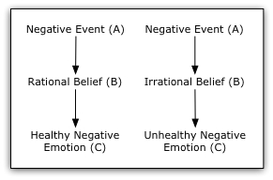

Cognitive Behavioural approaches
Rational emotive behaviour therapy
Developed by Albert Ellis, REBT looks at the irrational thinking that leads to destructive attitudes and entrenched patterns of behaviour in individuals. This process is called the ABC model.
Ellis talking with Phillip Adams on ABC radio
Source http://counsellingresource.com/types/rational-emotive/index.html:

Slide 23
Cognitive Behavioural approaches
Rational emotive behaviour therapy
REBT also employs three primary insights:
While external events are of undoubted influence, psychological disturbance is largely a matter of personal choice.
Individuals consciously or unconsciously select both rational beliefs and irrational beliefs at (B) when negative events occur at (A)

Slide 24
Cognitive Behavioural approaches
Rational emotive behaviour therapy
REBT also employs three primary insights:
While external events are of undoubted influence, psychological disturbance is largely a matter of personal choice.
Individuals consciously or unconsciously select both rational beliefs and irrational beliefs at (B) when negative events occur at (A)
Past history and present life conditions strongly affect the person, but they do not, in and of themselves, disturb the person.
It is the individual’s responses which disturb them, and it is again a matter of individual choice whether to maintain the philosophies at (B) which cause disturbance.

Slide 25
Cognitive Behavioural approaches
Rational emotive behaviour therapy
REBT also employs three primary insights:
While external events are of undoubted influence, psychological disturbance is largely a matter of personal choice.
Individuals consciously or unconsciously select both rational beliefs and irrational beliefs at (B) when negative events occur at (A)
Past history and present life conditions strongly affect the person, but they do not, in and of themselves, disturb the person.
It is the individual’s responses which disturb them, and it is again a matter of individual choice whether to maintain the philosophies at (B) which cause disturbance.
Modifying the beliefs and attitudes at (B) requires persistence and hard work, but it can be done.

Slide 26
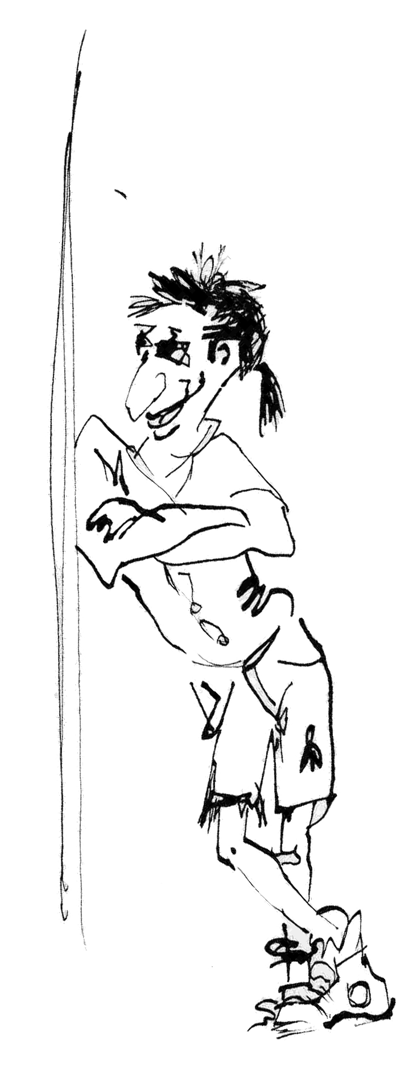
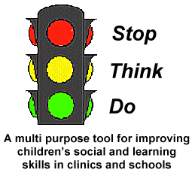
Cognitive Behavioural approaches
2
Approaches in cognitive restructuring
Talk Sense to Yourself:
A program for children and adolescents
Jeffrey Wragg
Lindy Petersen

Slide 27
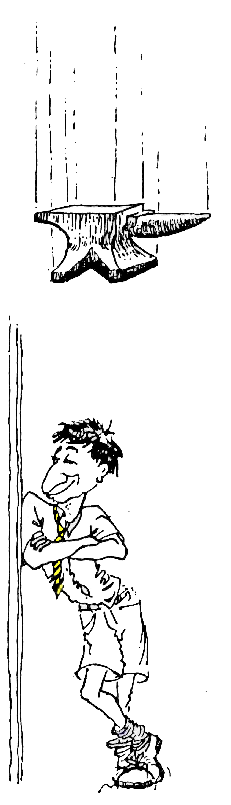

Talk sense to yourself
Jeff Wragg
Think consequences
Is it worth it?
What do I need to say to myself?

Slide 28
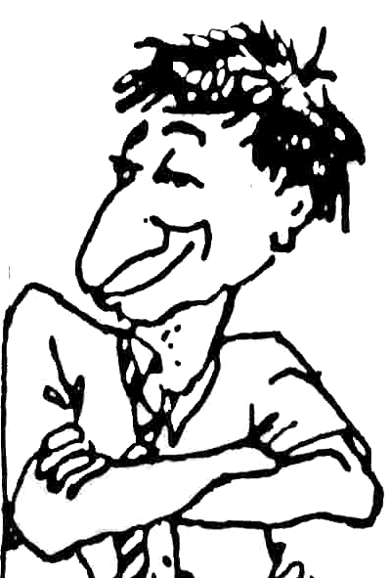
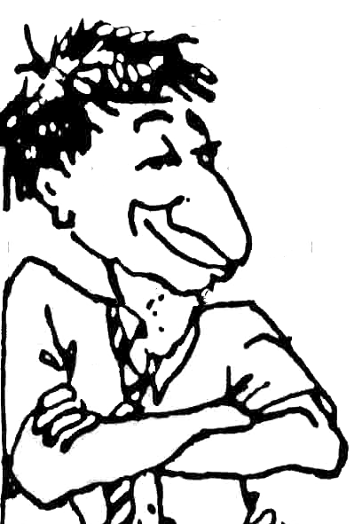
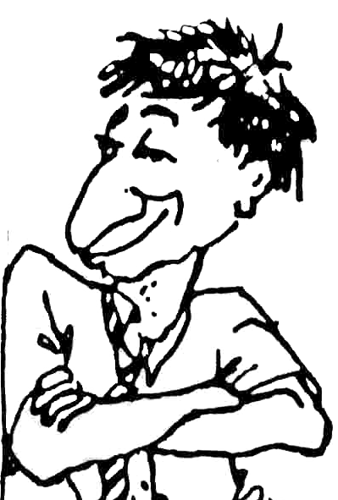


THINKING
This is boring
STOP
School sux
Think consequences
I didn’t do nothing
Only 10 minutes to recess
They always pick on me
It’s not worth it
TALKING TRASH
TALKING SENSE TO YOURSELF
ACTIONS – What am I doing?
Talking in class
Throwing things
Talking back to teachers
Hassling other kids
CONSEQUENCES – What happens?
✓
✓
✗
Mum gets upset
✗
Sent out
Suspension
✓
✗
Detention
Interview with principal
IS IT HELPING ME? IS IT WORTH IT?
YES / NO

Slide 29
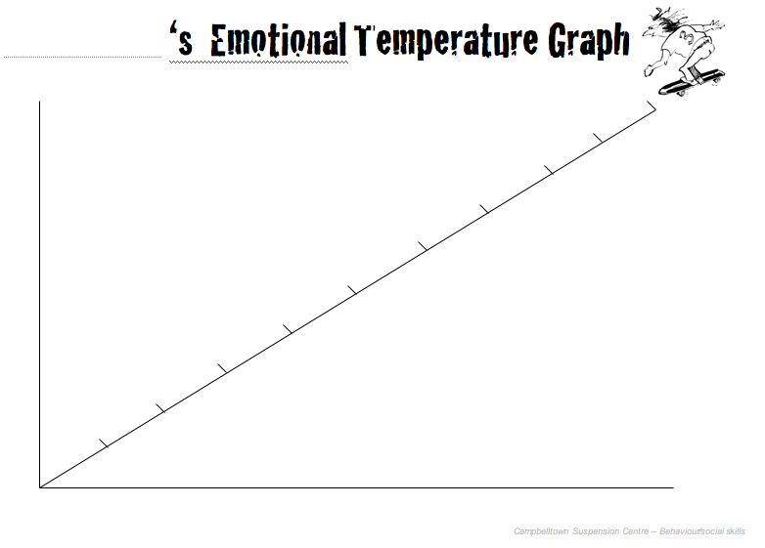
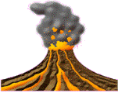
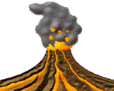
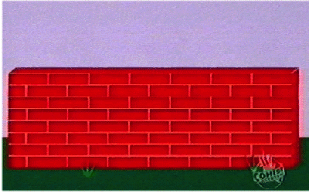
Emotional temp graph
Anyone
Start fighting and yelling
10
STOP
Think Consequences
Is it worth it?
9
8
Throwing things
Swearing
Hitting out
Walk over and push them
7
6
Push back and call me a wanker
5
Answer back
Out of control
4
Feeling good
3
Keep saying things
Mention my mum
2
Get called names
1
0
In control

Slide 30
References
Wragg, J. (1989) Talk Sense to Yourself. A program for children and adolescents. ACER: Camberwell, VIC
Boeree, G.C. (20006) Personality Theories – Albert Ellis. Website accessed 23/2/2011 at http://webspace.ship.edu/cgboer/ellis.html
Petersen, L. & Gannoni, A.F. (1992) Stop, think. do: Teacher's manual for training social skills while managing student behaviour . ACER, Hawthorn, Vic.

