Slide 1
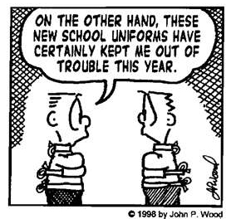
EDPS302 Week 1
Creating Positive Learning Environments

Slide 2
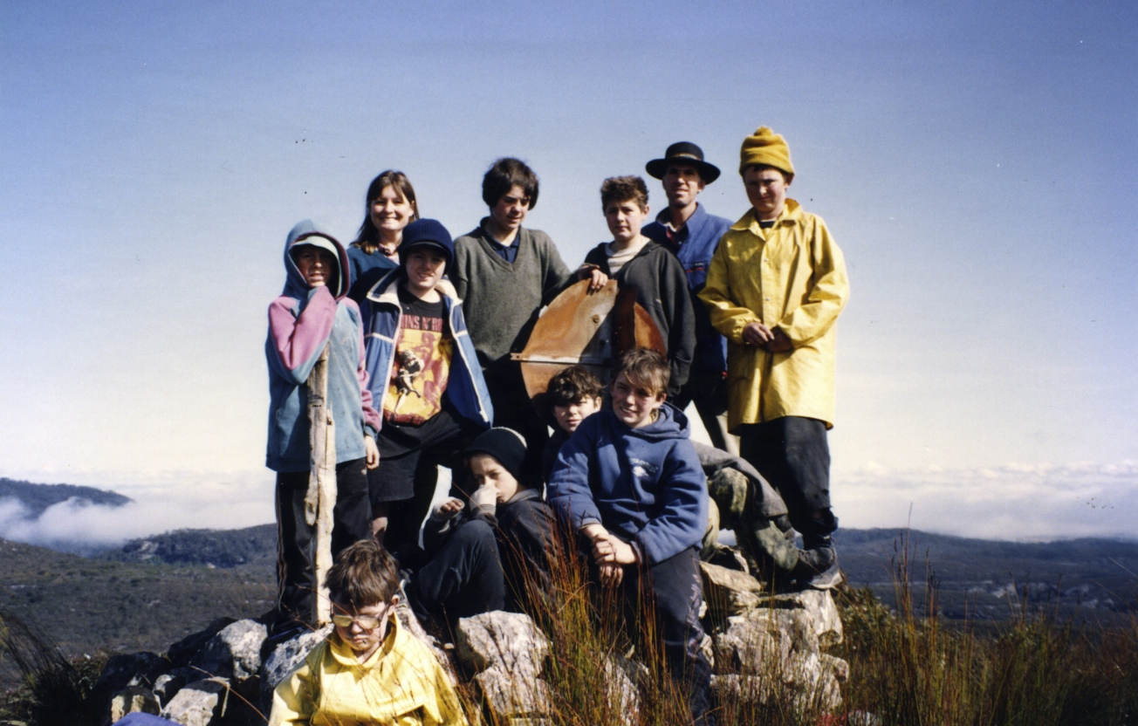
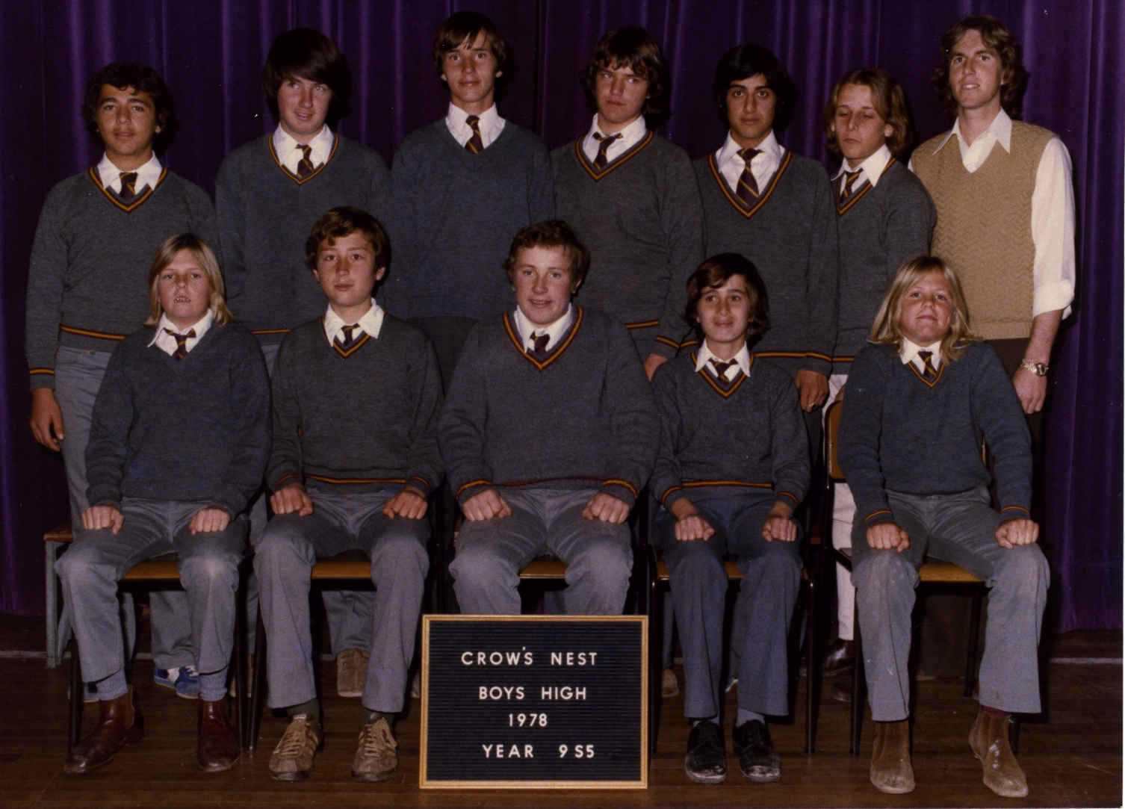
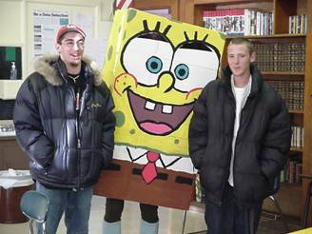
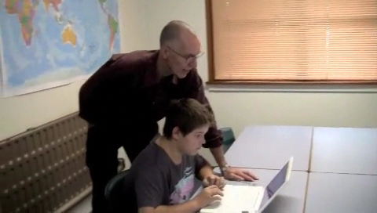
. . . a bit of history
. . . a bit of my history
Wilderness enhanced program
Principal – alternative school, Maine, USA
Head teacher – Campbelltown Suspension Centre
General teacher

Slide 3

A NEW PEDAGOGY
Supporting quality teaching and learning through the integration of information and communication technologies into a curriculum structured and delivered to accommodate the learning needs of all students

Slide 4
The art of teaching
. . . . in 2017 & beyond
. . . weave some magic
. . . create some flow
. . . laugh
and learn

Slide 5
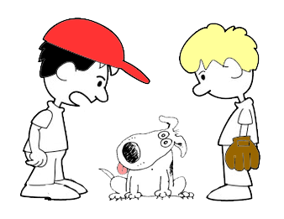
I’ve taught my dog to talk
But your dog can’t talk
I know.
I said I taught him, not
that he learnt how to do it.

Slide 6
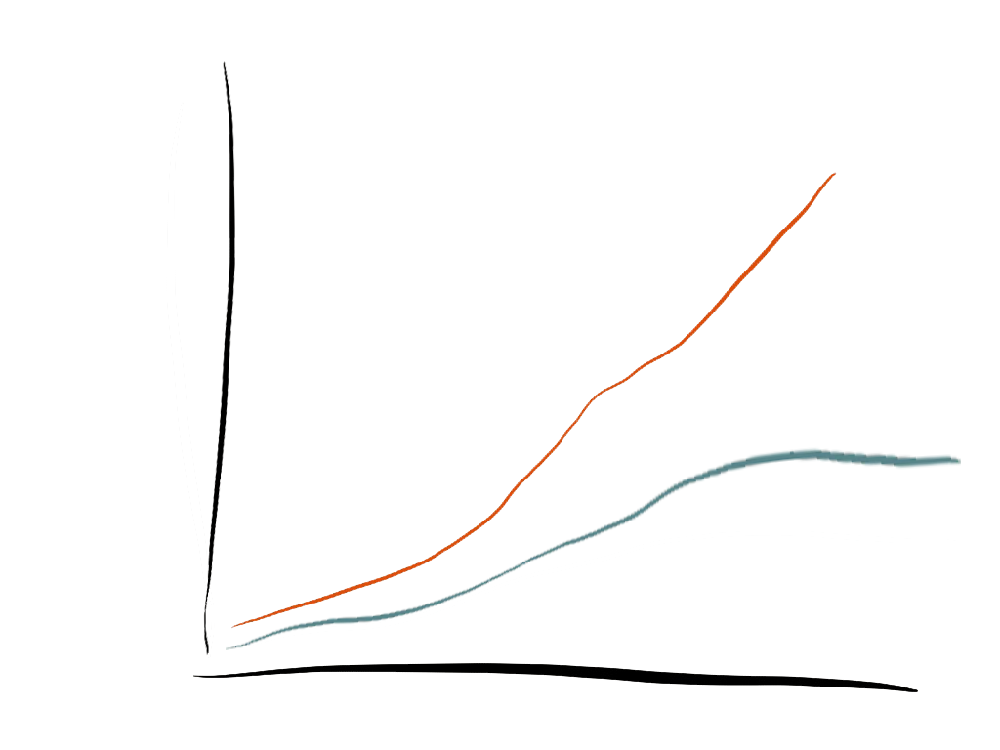
Achievement gap
Learning
Competent student
12
11
10
9 8 7
6
5
4
3
2
1
K
75%
At-risk student
K 1 2 3 4 5 6 7 8 9 10 11 12

Slide 7
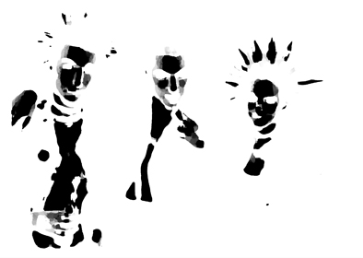

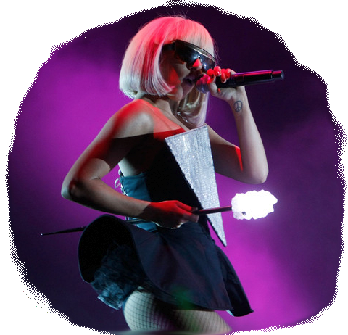

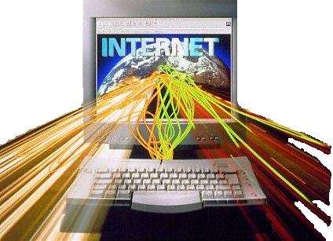

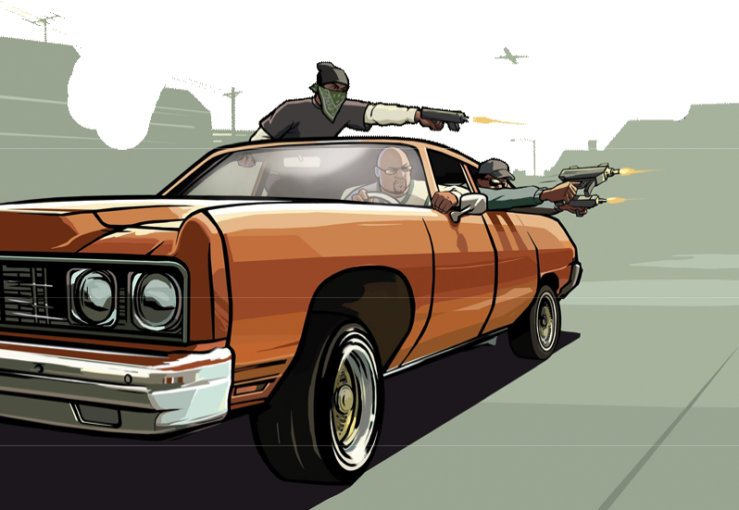
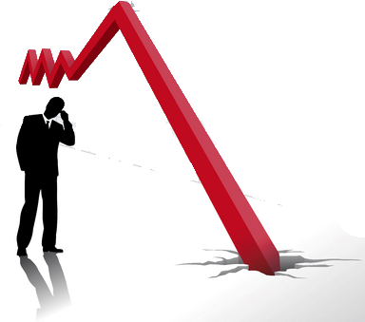
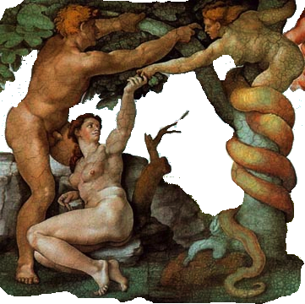


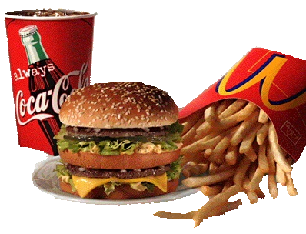
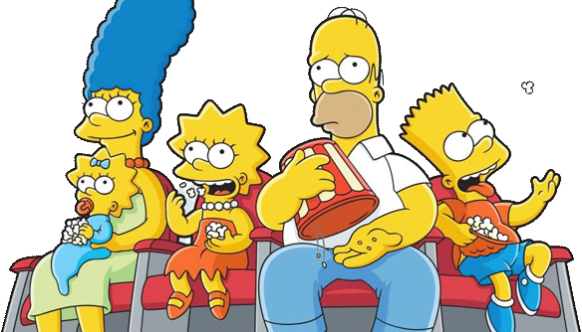
Scapegoats of misbehaviour
Internet
pop culture
innate evil
video games
the media
economic downturn
factors not causes
loss of values
diet
social networking
drugs
dysfunctional families

Slide 8
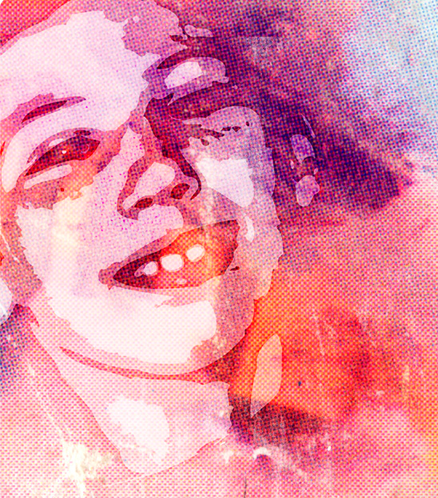
Understanding disadvantage
Understanding disadvantage
In Australia the impact of students’ socioeconomic status, or SES, on the achievement profile of a school is close to the OECD average, but the impact of school SES on student achievement is among the highest in the OECD.
(PISA, 2009)
Main risk factors are:
level of parent education
indigenous background
remote location
disability
?

Slide 9
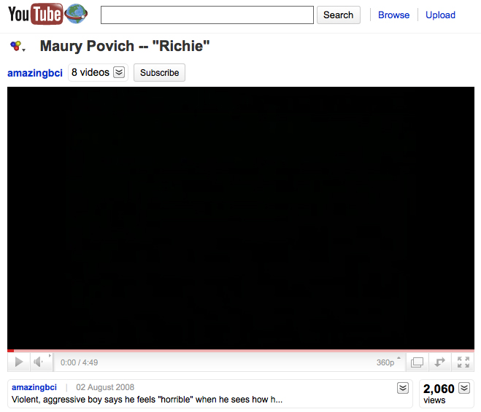


Slide 10
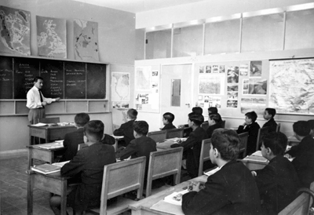
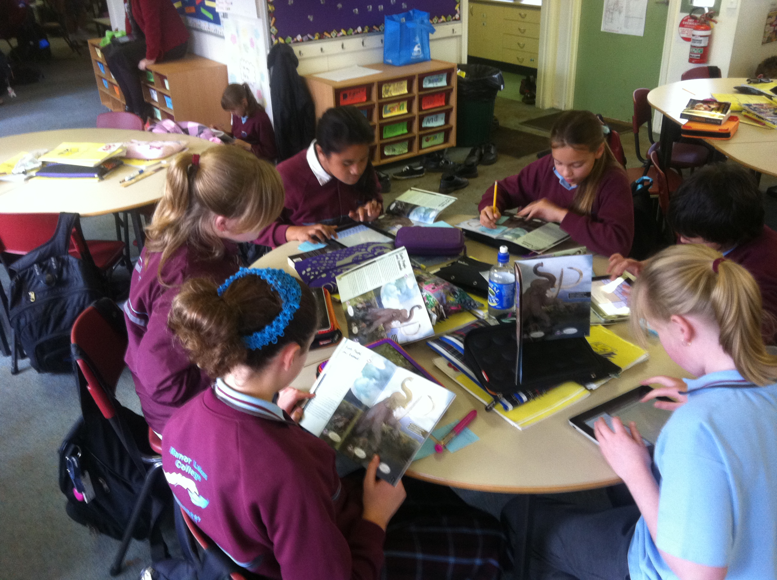

Skill of teachers
Role of teachers
Prior to 1970 – knowledge, integrity, firmness, compassion
Authority
1970 to 1998 – knowledge, compassion, flexibility, patience, control
Discipline
Post 1998 – flexibility, innovation, humour, facilitation, patience, self control, assessment, design, adaptability
Engagement

Slide 11
Perspectives on (mis)behaviour
Dreikurs
Balson
All behaviour has a goal or purpose
Glasser
Carl Rogers
Thomas Gordon
All people have needs which they seek to meet.
Myers-Briggs
Gardner
VARK
Hermann
People have a variety of personality types, learning styles and preferences.
Durrant
White
De Shazer
Derived from incongruent interactions.

Slide 12
Behaviour as a Goal - Adler/Dreikurs/Balson
Dreikurs believed that all humans have a primary need to belong and feel part of a group.
This sense of belonging can be achieved through positive interaction but when this fails children turn to negative mistaken goals of behaviour.
Dreikurs states, “no person behaves without intending to affect others, though people are usually not aware of the purpose of their behaviour.” (Dreikurs 1961).

Slide 13



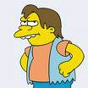

Goals of Behaviour
the undue attention seeker
keeps others busy or tries to get special services
the power seeker
wants to be boss
revenge
trying to get even
the display of inadequacy or withdrawal
gives up and wants to be left alone

Slide 14
Reading the Goal of Students
From http://www.montessori.asn.au/lib/4.htm
There are two reliable approaches to understanding the goal of a child's behaviour.
1. Observe your own spontaneous and impulsive reaction to the child's behaviour. What teachers/parents feel like doing is exactly what children want them to do.
2. Observe the child's reaction to teacher/parental correction.
Child's Goal
How teacher feels
How Child Reacts
Attention seeking
Annoyed
Temporarily stops
Power
Personally challenged
Continues to disturb
Deeply hurt
Revenge
Becomes more aggressive
"Hopeless"
Inadequacy/withdrawal
Uninterested
For a detailed Mistaken Goals Chart go to http://resources.sai-iowa.org/bd/mistakengoal.pdf

Slide 15







Needs based - Choice Theory (Glasser)
Our behaviour is directed at meeting our basic needs:
Students can be focused on being aware of their behaviour and how best it can meet their needs.

Slide 16
Gardiner’s Multiple Intelligences
1. Linguistic
2. Logical-Mathematical
3. Bodily-Kinesthetic
4. Spatial
5. Musical
6. Interpersonal
7. Intrapersonal
INTRAPERSONAL
These children may be shy. They are very aware of their own feelings and are self-motivated.
LINGUISTIC
Children with this kind of intelligence enjoy writing, reading, telling stories or doing crossword puzzles.
LOGICAL/MATHEMATICAL
Children with lots of logical intelligence are interested in patterns, categories and relationships. They are drawn to arithmetic problems, strategy games and experiments.
BODILY/KINESTHETIC
These kids process knowledge through bodily sensations. They are often athletic, dancers or good at crafts such as sewing or woodworking.
SPATIAL
These children think in images and pictures. They may be fascinated with mazes or jigsaw puzzles, or spend free time drawing, building with Lego or daydreaming.
MUSICAL
Musical children are always singing or drumming to themselves. They are usually quite aware of sounds others may miss. These kids are often discriminating listeners.
INTERPERSONAL
Children who are leaders among their peers, who are good at communicating and who seem to understand others' feelings and motives possess interpersonal intelligence.

Slide 17
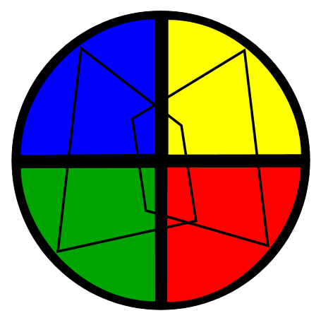
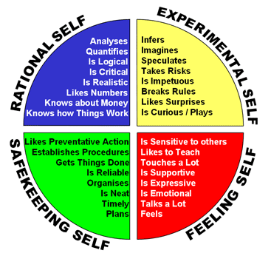
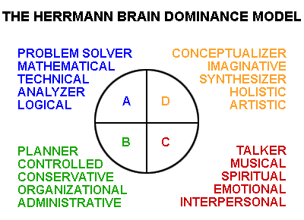
Learning Preferences
Hermann Brain Dominance Instrument
http://www.hbdi.com/home/

Slide 18
Learning Preferences - VARK
Visual
Auditory/aural
Read/write
Kinesthetic
PREFERENCES
Learning style
From VARK : http://www.vark-learn.com/

Slide 19
Personality Profiles - Myers-Briggs
The identification and description of the 16 distinctive personality types that result from the interactions among the preferences.
Favorite world
Extraversion (E) or Introversion (I)
Information
Sensing (S) or Intuition (N)
Do you prefer to focus on the outer world (E) or on your own inner world (I)?
Do you prefer to focus on the basic information you take in (S) or do you prefer to interpret & add meaning (N)?
Decisions
Thinking (T) or Feeling (F)
Structure
Judging (J) or Perceiving (P)
When making decisions, do you prefer to first look at logic & consistency (T) or first look at the people & special circumstances (F)?
In dealing with the outside world, do you prefer to get things decided (J) or do you prefer to stay open to new information and options (P)?
From http://www.myersbriggs.org The MBTI® Manual: A Guide to the Development and Use of the Myers-Briggs Type Indicator®

Slide 20
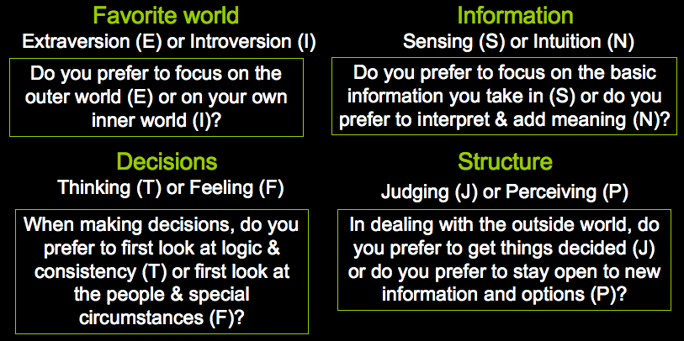
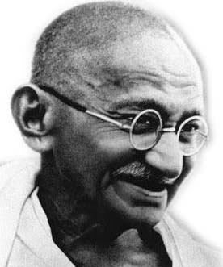
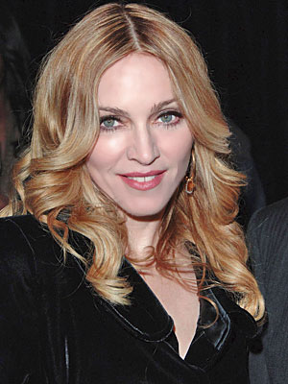
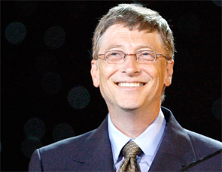
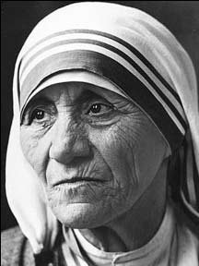
Personality Profiles - Myers-Briggs
INFP Albert Schweitzer
INFJ Mohandas Gandhi
ENFP Carl Rogers
ENFJ Mikhael Gorbachev
ISFP Barbara Streisand
ISTP Clint Eastwood
ESFP Elvis Presley
ESTP Madonna
INTP Albert Einstein
INTJ Dwight D. Eisenhower
ENTP Walt Disney
ENTJ Bill Gates
ISTJ Queen Elizabeth II
ISFJ Mother Theresa
ESTJ Colin Powell
ESFJ George Washington

Slide 21
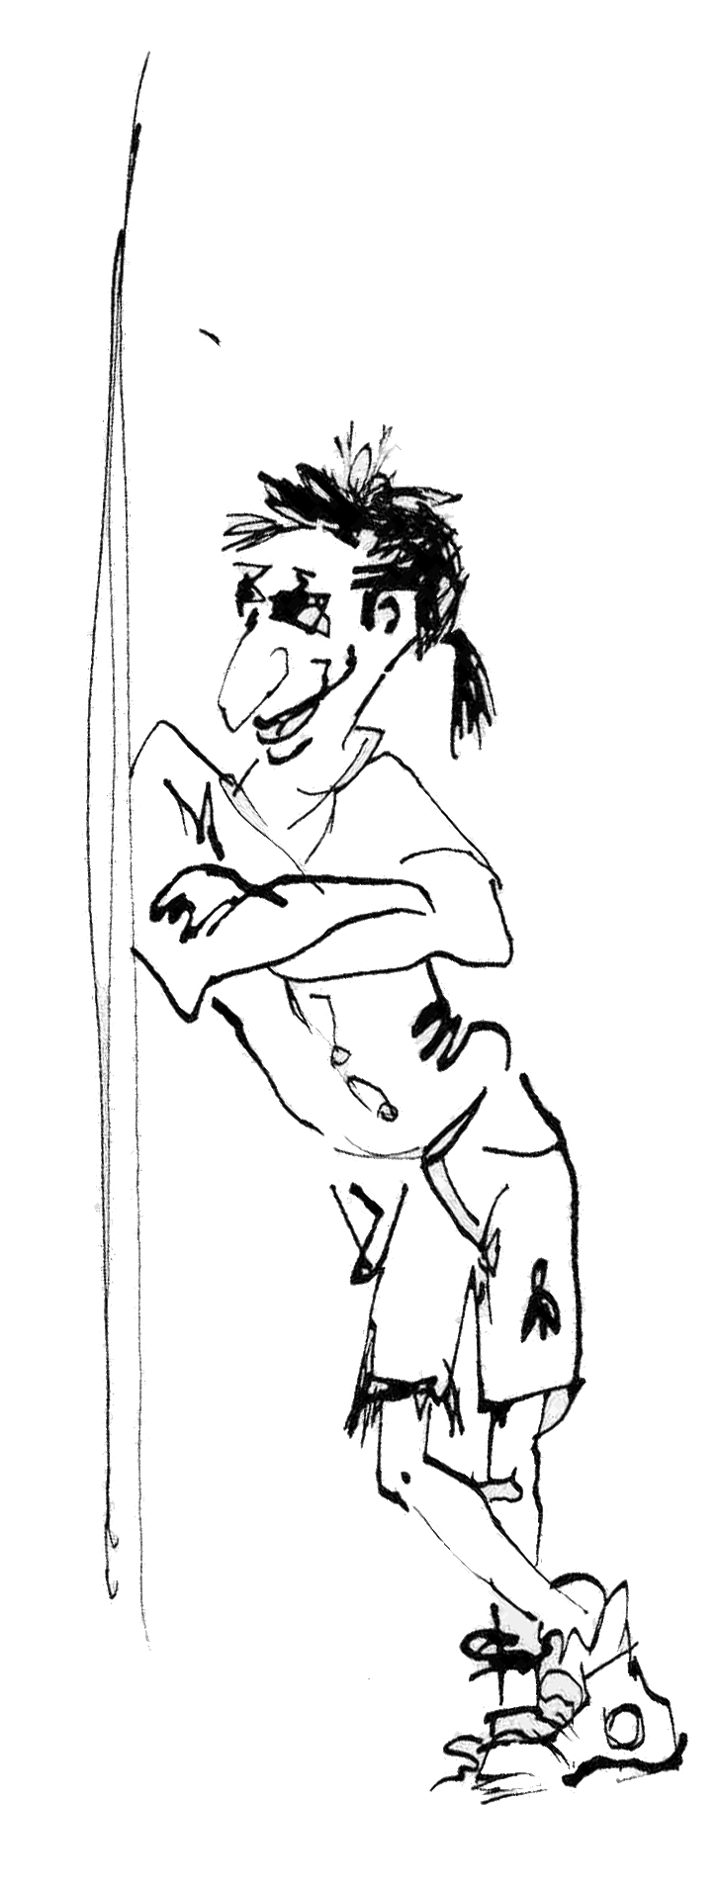
Learning Disabilities/Disorders
Anxiety
Asperger's Syndrome
Attachment Disorder
Attention Deficit/Hyperactivity Disorder (ADHD)
Autism
Bipolar disorder
Bulimia Nervosa
Conduct Disorder
Depression
Eating disorder
Oppositional Defiant Disorder
Posttraumatic Stress Disorder
Schizophrenia
Separation Anxiety Disorder
Tourette's Disorder
(DSM –IV)

Slide 22
BEHAVIORS ASSOCIATED WITH ADHD
(BARKLEY, 1990)
1. Poorly sustained attention in almost all situations
2. Diminished persistence on tasks not having immediate consequences
3. Impulsivity, poor delay of gratification
4. Impaired adherence to commands to regulate or inhibit behavior in social contexts
5. More active, restless than normal children
6. Difficulty adhering to rules and regulations
BEHAVIORS ASSOCIATED WITH GIFTEDNESS
(WEBB, 1993)
1. Poor attention, boredom, daydreaming in specific situations
2. Low tolerance for persistence on tasks that seem irrelevant
3. Judgment lags behind development of intellect
4. Intensity may lead to power struggles with authorities
5. High activity level; may need less sleep
6. Strong sense of justice and fairness can lead to impetuous and disruptive behaviour when rules or conditions seem unfair.
Source: Webb & Latimer 1993 ED358673 1993-07-00 ADHD and Children Who Are Gifted. ERIC Digest #522.

Slide 23

Brandon
Year 10
Constantly either truanting or suspended
Moves between mum in Sydney and dad in Newcastle
Does not complete work and constantly making comments, moving around and fidgeting.
8.
John takes 1 minute to walk 100 metres. Kylie takes 5 minutes to walk 400 minutes.
If they start off together, how far ahead will one be of the other after 10 minutes?
A 100 metres
B 200 metres
C 300 metres
D 500 metres

Slide 24
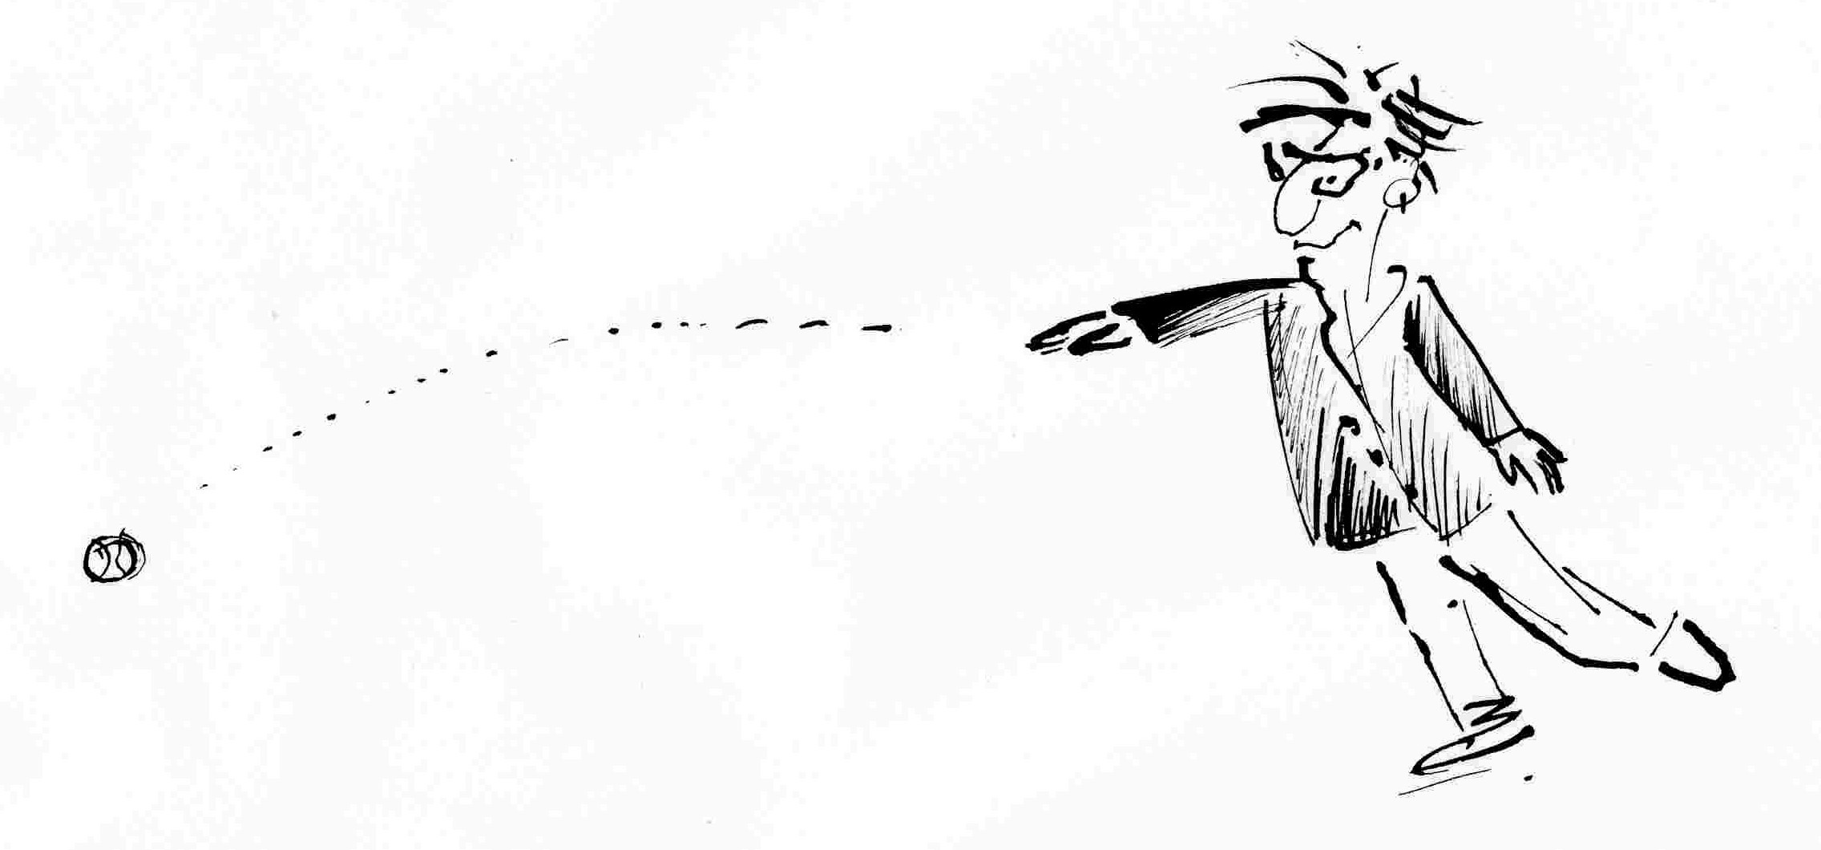
‘Nothing is as dangerous as an idea
‘Nothing is as dangerous as an idea when it is the only one you have.’ Emile Chartier
(from A guide to possibility land (1997) by Bill O’Hanlon and Sandy Beadle)

Slide 25
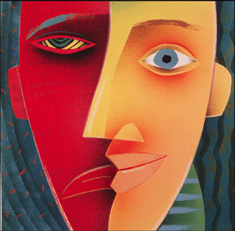
Interactional Incongruency
Not about what we do or what kids are like . . it is about what happens in the spaces in-between.
When we generate the opposite results to what we really intend by our actions
Notes:
We create incongruent interactions when we do or say things that create negative feelings between us and the
people we’re interacting with, or when we generate the opposite results of what we really want.

Slide 26
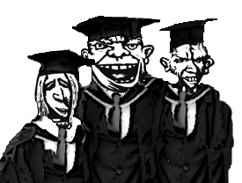
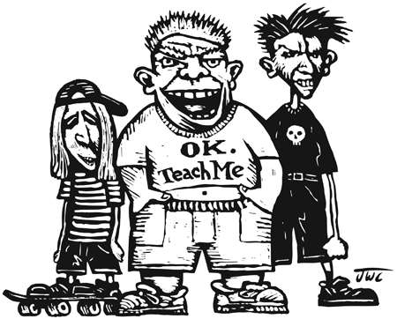
the stuff of teaching

Slide 27
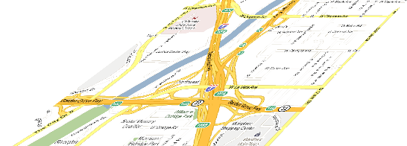



The Management Map
Intervention ownership
External control
External control
Staff actions
Staff actions
Internal control
Client actions
Internal control
Client actions
preventive
corrective
restorative
anticipation
crisis management
relational
design
regenerative
responding
reacting
protection
management
solution focussed
Notes:
This is just an additional model not covered in the CPI notes and manual. It highlights the difference level of staff involvement or action depending of the position on the crisis cycle. When nonviolent physical intervention is used the clients loses almost total control over their actions - although this can be quickly changed as they calm down and move with either back to a defensive position or on towards tension reduction.

Slide 28
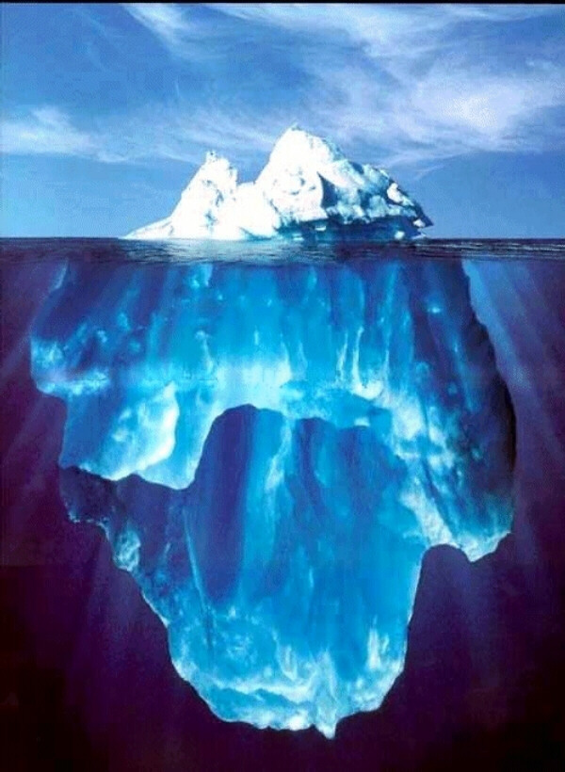


PRECIPITATING FACTORS, RATIONAL DETACHMENT, INTEGRATED EXPERIENCE
Precipitating Factors
Internal or external factors over which teachers have little or no control
Examples:
family issues
hunger
rejection
failure
grief
displaced anger
weather
health issues
drugs
fear for safety
disabilities
Notes:
Understanding precipitating behaviours can help staff:
Prevent acting out behaviour
Depersonalise crisis situations by recognising other factors at play beyond our affect
Stop us from becoming part of the problem

Slide 29

A WINDOW ON BEHAVIOUR
Problem owned by others
Response to focus on the problem
Personal feelings and thoughts explained
Stress is controlled by you
Remedies
Acceptable Behaviours
breathe
humour
change course
take a break . .
(detached/calm)
All
behaviours
experienced
Line of responsibility
Symptoms
sick feeling
sweating
panic
raised voice
Problem owned by us
Reaction that focuses on blame and denial
Personal attack used to fight back and hurt other person
Generalisations & absolutes
Stress controls you
Unacceptable behaviours
(taken personally)
adapted from Thomas Gordon (1974) Teacher Effectiveness Training. Wyden Publishing, NY.

Slide 30

Words and expressions we use when we own the problem
. . . and lose our rational detachment
Why don’t you . . . . . ?
When are you . . . . . ?
But . . . . .
You should . . . . .
Every time I . . . . .
You never . . . . .

Slide 31
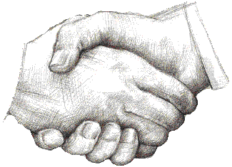
Words and expressions we use to enable other people to resolve an issue
What happened . . . . . ?
What can I do to . . . . . ?
. . . and . . . . .
Is it worth it ?
Sometimes I . . . . .
What is different about . . . . . ?
What would you do if you were in my shoes?

Slide 32
Additional references
Balson, M. 1992 Understanding classroom behaviour 4th edn, ACER Melbourne
Dreikurs, R & Cassel, P. 1990 Discipline without tears. 2nd edn, Dutton, New York
Gardner, Howard 1983 Frames of mind: The theory of multiple intelligences, Basic Books, New York.
Glasser, W. 1998 Choice theory in the classroom. Harper Perennial, New York.
Gordon, T. 1974 Teacher effectiveness training, Wyden Press, New York.
Notes:
We create incongruent interactions when we do or say things that create negative feelings between us and the
people we’re interacting with, or when we generate the opposite results of what we really want.

