Slide 1

EDPS302 - Creating Positive Learning Environments
Models of behaviour management
Lecture 2
August 1, 2017
Ray Handley

Slide 2
EDPS302 - Creating Positive Learning Environments
This week
planning for behaviour
overview of models – continuum
Key skills to development
Dummies guide to teaching

Slide 3

the quality skills of teaching
(NSW DEC)
The word ‘pedagogy’ originated from the Greeks, to mean “child” and “lead”, then put them together to get a literal meaning – “to lead the child”.
In Ancient Greece, a slave (paidagogos) was assigned to a wealthy master’s son, to take him to school, supervise him while in school, and carrying his equipment such as musical instruments.
activities that impart knowledge
(University of Tasmania)
the art or science of teaching; education; instructional methods.
(Dictionary.com)
the art of teaching
(Qld DET)
Let’s talk ‘pedagogy’

Slide 4


Palate
PEDAGOGY - getting the right mix
Information
TEACHERPRACTICE
TEACHERTRAINING
Information
Information
Philosophy
Philosophy
Philosophy
Skills
Skills
Skills
Personality
Personality
Personality

Slide 5




Plan
principles & philosophy
Framework
personal
theories & approaches
skills & strategies
Models
Practice
researched & understood
applied & reviewed

Slide 6

Framework
Framework for Teaching
consistent
A approach with sound, well communicated principles,
that allows actions
in response to individual circumstances,
flexible
ongoing
and reflects an belief
in the inevitability of change

Slide 7
Models
Models for Teaching
teacher centred
learning is a response to changes in the environment in which it occurs
Behaviourist approaches
reward/punishment
+ve/-ve reinforcement
teacher centred
learning results from changes in thinking
Cognitive approaches
looks for patterns & beliefs
student centred
Constructivist approach
learning is an active process of creating meaning from different experiences
teacher is a guide to learning
Notes:
Behaviourist and cognitive - teacher centred. Change behaviour by either changing the situation in which the beahviour occurs (environment through rewards, consequences, punishments, reinforcements or by changing the thinking behind the behaviour ( attitudes, beliefs, self talk, intentions)
Constructivist approach is student centred. This theory states that learning is an active process of creating meaning from different experiences. In other words, students will learn best by by trying to make sense of something on their own with the teacher as a guide to help them along the way. (Brooks, J. and Brooks, M. (1993). In Search of Understanding: The Case for Constructivist Classrooms, ASCD)

Slide 8

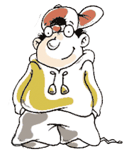
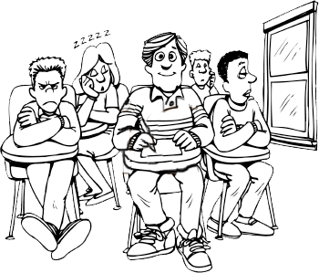
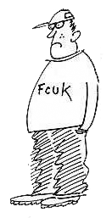
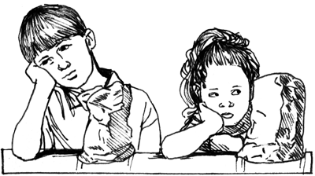
Student qualities
Ability
Can do
Can’t do
Selective
Schools
Will do
Student Qualities
SSPs
Special
Units
Motivation
Won’t
Behaviour
Schools
Mainstream schools

Slide 9
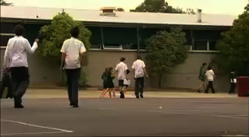
Jonah
Ability
Can do
Can’t do
Will do
Student Qualities
Motivation
Won’t

Slide 10
Overview of models
Overview of the models
Fred Jones - Positive Discipline
Jacob Kounin - Preventative discipline
Canter & Canter - Assertive Discipline
B.F. Skinner - Applied Behaviour Analysis
Bill Rogers
Decisive Discipline
Integration of teaching and discipline
Ripple Effect, Withitness, Overlapping, Effective Transitions, Group Focus, Satiation
4Rs - rights, rules, responsibilities, routines
Clear behaviour plan
Avoid secondary behaviours
Clear rules/consequences
Positive reinforcement
Firm teacher role
Meeting needs of students
Creative/divergent thinking
Mastery learning
Focus on actions
Functional assessment
Planned response
Positive interactions
Encouragement not praise
Negotiation
Democratic relationships
Cost of praise
Understanding goals of behaviour
Body language
Incentives
Positive relationships
Focus on thinking
Challenging beliefs
Planning changes
Looking for exceptions
Doing it differently
Scaling
Focus on positive emotions and strengths to achieve happiness
Dreikurs, Balson – Goals of behaviour
William Glasser
Quality Schools
Cognitive Behavioural - Ellis, Wragg, Peterson
Haim Ginott, Carl Rogers - Humanist approaches
Positive psychology- Seligman, Csikszentimalyi
Strengths Based Intervention - Durrant, Kowalski

Slide 11

Models continuum
Bill Rogers
Decisive Discipline
Humanism
Ginott/Rogers
Jacob Kounin
Group Management
Positive Psychology
Seligman/Csikszentmihalyi
Fred Jones
Positive Discipline
Neo-Adlerian
Balson/Dreikurs
Systems Theory
Solution focussed
Applied Behaviour
Analysis
Behaviour Modification
Choice Theory
William Glasser
Canter & Canter
Assertive Discipline
Cognitive-behaviourism
Models of Behaviour Management Continuum
Student empowered
Internal motivation
Autocratic
Limit Setting
Laissez-faire
Non-directive
Teacher empowered
External motivation
Democratic
Leadership

Slide 12

CDM - Therapport
The Crisis Development Model
exp
integrated
erience
Crisis development/behaviour levels
Staff attitudes/Approaches
1.
Anxiety
Supportive
2.
Defensive
Directive
Nonviolent physical crisis intervention
3.
Acting out person
4.
Tension reduction
Therapeutic rapport
Reasons for using the Crisis development Model
helps us to intervene early and appropriately
helps us to avoid overreacting or under-reacting
helps us to avert a crisis
Notes:
Integrated experience is inserted here to introduce an awareness that the behaviour of clients and the actions of staff affect or feedback to each other.

Slide 13

Session four
Keys skills across approaches

Slide 14


Setting Limits – 5 steps
Setting limits
directly
Explain which behaviour
is inappropriate
Be prepared to enforce
your consequences.
5
Calm & respectful
Enforceable
Explain why the behaviour is inappropriate.
Steps
Allow time.
Short & simple
Reasonable
Give reasonable choices
with consequences.

Slide 15
Setting Limits – 5 steps
Setting limits
script
Interrupt & redirect
Jarryd, back to work
Use their name to get attention.
When . . . . . & then . . .
When your work is finished you can go to lunch
State expected behaviour & what will result
If . . . . & then . . . . . .
If your work is not finished then you will have to come at lunchtime and I will help you.
State present behaviour & consequences.

Slide 16
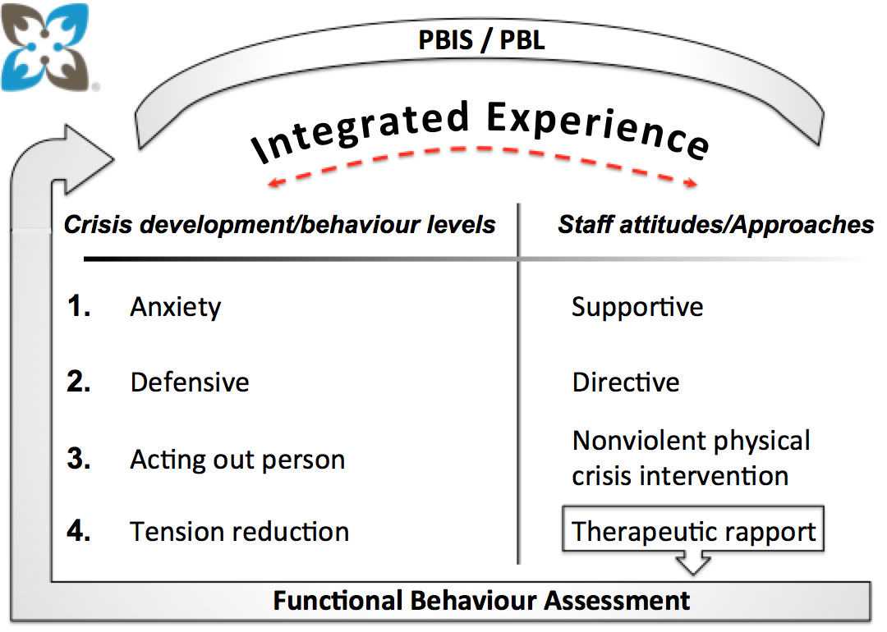

Defensive/Directive Level
Setting limits
Setting limits is a central component of the Directive Staff Attitude/Approach. It is the recognition that we cannot force an individual to behave in a specific way. Rather, we explain choices and consequences and help the person make positive choice
Behaviours at this stage may include noncompliance, walking away, or avoiding eye contact. Be aware sometimes what staff think is refusal might actually be ____________ .
To effectively set limits with an individual with ASD, we can:
Use “weighted choices”
___________ limits.
Be flexible and creative
_______ explain choices and consequences.
confusion
You set the limits, but the child gets the choice eg.
You can say, “You can read your book here in the classroom or out in the hall”.
Individualise
You can say, “You can take your medicine with pudding or applesauce”.
Visually

Slide 17


Non-direct limit setting
Setting limits
Refocus
on primary behaviour/main issue
& away from personal issues
Agree
with feelings/emotion
non-directly / strategically
Negotiate
What can I do to …..
Reinforce
Instances of difference (past experiences)
Behaviour of others
Issue continues
Issue resolved

Slide 18
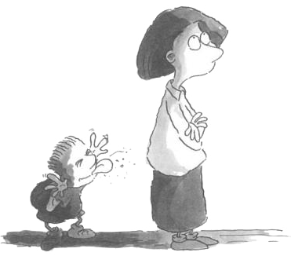
Tactical ignoring
Tactical ignoring
Tactical ignoring is a conscious decision to ignore certain behaviour and keep the focus on the flow of the lesson, or on acknowledging and reinforcing positive behaviour.
For example - a teacher ignores several students calling out. A general rule reminder is given to the whole class:
'Remember our rule for hands up, everyone.'
Rogers, B. (2007) Behaviour Management: A Whole-School Approach. UK: Sage (p139)

Slide 19
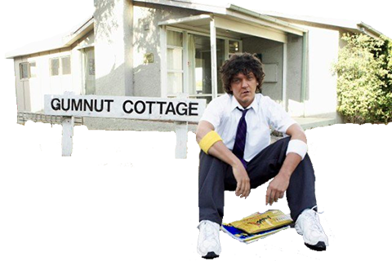

Gumnut cottage
Tactical ignoring

Slide 20
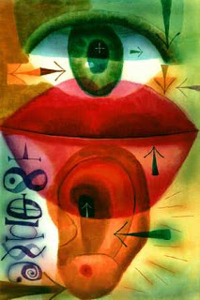
Empathic listening
Reflective or empathic listening skills
Some key principles:
More listening than talking
Trying to understand the feelings contained in what the other is saying, not just the facts or ideas.
Responding with acceptance and empathy, not with indifference, cold objectivity or fake concern.
Restating and clarifying what the other has said, not asking questions or telling what the listener feels, believes or wants.
Responding to what is personal rather than to what is impersonal, distant or abstract.
Sensing of the other's frame of reference while avoiding the temptation to respond from the listener's frame of reference.

Slide 21
Empathic listening script
Reflective or empathic listening skills
A simple script:
What happened?
Can you tell me what happened?
Intro
You feel angry when . . . .
So you are angry/frustrated/disappointed that . . . .
You think it is unfair when . . . .
It seems like you are being picked on . . .
Reflective
listening
So let me see if I have it right. So you are angry that . . . . . . and frustrated with . . . . . . . And when this happens
  . . . . . . . . . . . . . . . . . . . . . . . . . . . . . . . . . . . . . . . . . . . . . . . . . . . . . . . . . . . . . . . . . . . . . . . . . . . . . .
Influential
summary
(the issue in your words from what you have understood while listening to the other person)

Slide 22
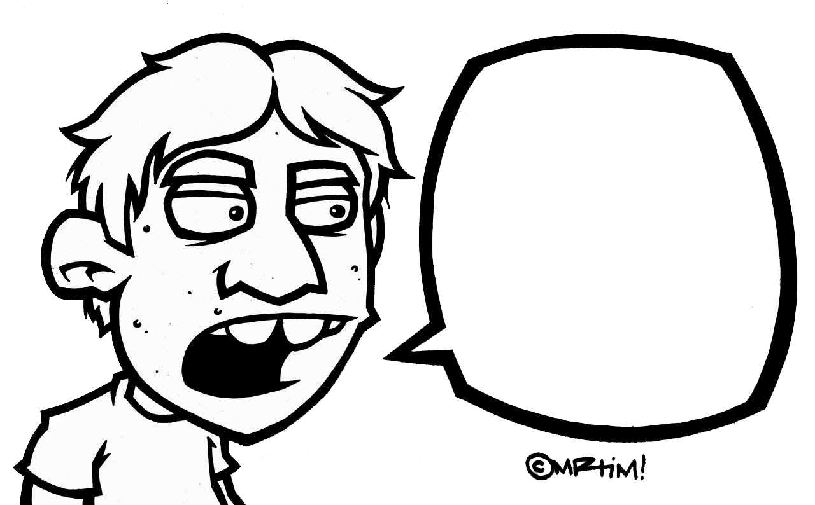
Quick Guide to defiance
Quick guide to handling defiance
A QuickGuide to managing defiance
STEP 1
Stay calm / Detach / Take a breath
STEP 2
Tactically ignore / keep detaching
Respond to anxiety / use negotiating question / introduce confusion
STEP 3
STEP 4
No
Seek help
I’m not doing it
Fuck you

Slide 23
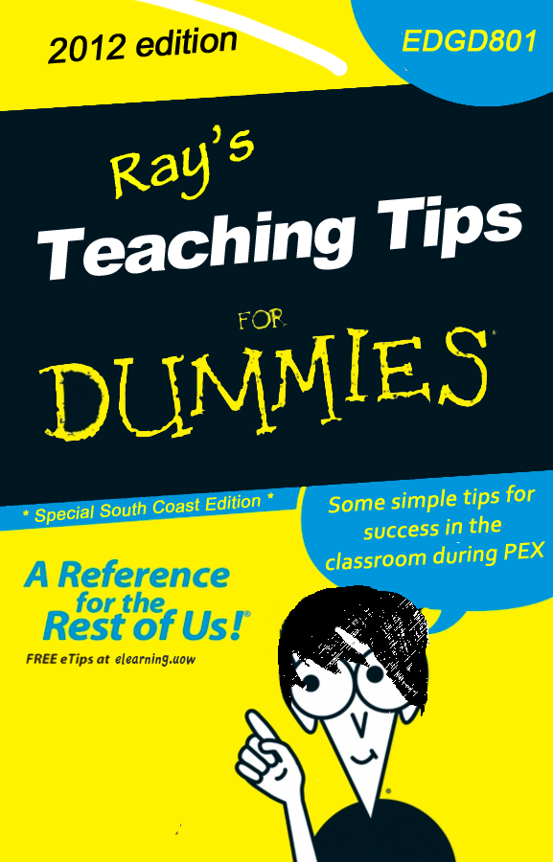
Dummies guide cover
2014
EDPP302
The ‘ FOR DUMMIES’ series of publications and website resources is the property of Wiley Publishing, Inc. All rights reserved.
Find out more: http://au.dummies.com/Section/index.html

Slide 24
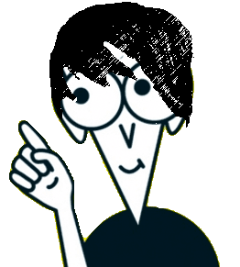
Contents
Introduction
9 tips for survival in the classroom
Realistic expectations
A thick skin
The moving target
More than intentions
Button pushing
More poker than pedagogy
Use your instincts
Keep cool
Chunk/funk/dunk
Ray’s Teaching tips for dummies

Slide 25
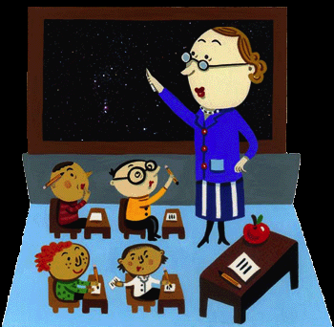
Introduction
You’ve done the MindMap, looked at many of the theories and seen some of the approaches recommended.
So what happens now. . .
Here’s a common sense guide to applying this knowledge for success with teaching kids in your classroom.
Ray’s Teaching tips for dummies

Slide 26

9 teaching tips
# 1
Realistic expectations
Don't go in with the expectation that teaching kids will make you feel good.
Just feel good to be working with kids.
Ray’s Teaching tips for dummies

Slide 27

9 teaching tips
# 2
A thick skin
You need a thick skin
. . . and some body armour wouldn't be a bad idea.
metaphorical
^
Ray’s Teaching tips for dummies

Slide 28

9 teaching tips
# 3
The moving target
Understand you are an easy target
. . . so move around.
Ray’s Teaching tips for dummies

Slide 29
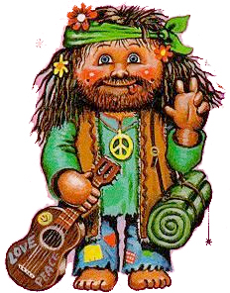
9 teaching tips
# 4
More than intentions
Just being caring, enthusiastic and young doesn't mean a thing
. . . on their own.
Ray’s Teaching tips for dummies

Slide 30
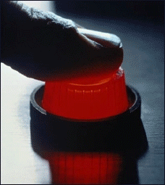
9 teaching tips
# 5
Button pushing
Kids like to press buttons
. . . and you are the biggest one around.
Ray’s Teaching tips for dummies

Slide 31


9 teaching tips
# 6
More poker than pedagogy
Managing student learning is just as much a mix of theatre and poker as knowledge and skills
. . . know when to hold them and know when to fold them.
It’s largely bluff and dare.
Ray’s Teaching tips for dummies

Slide 32

9 teaching tips
# 7
Use your instincts
Use your instincts and intuition
. . . by the time you know what students are up to it is already too late.
Ray’s Teaching tips for dummies

Slide 33

9 teaching tips
# 8
Keep cool
At all costs keep your cool.
. . . and learn how to find it when it gets lost..
Ray’s Teaching tips for dummies

Slide 34
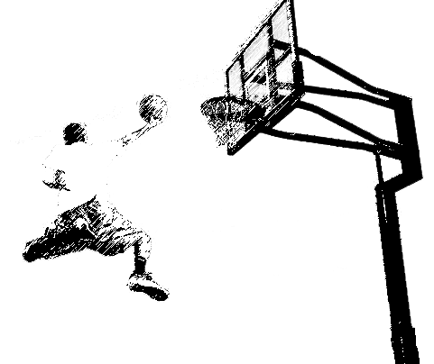
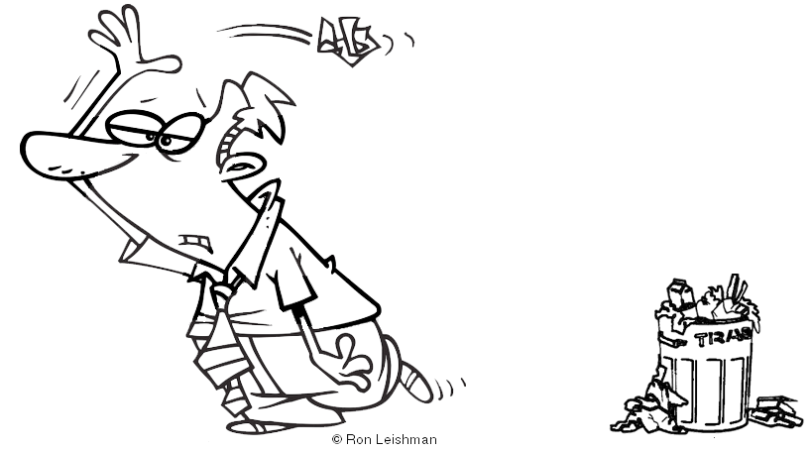
9 teaching tips
# 9
Chuck/fuck/duck
Chunk/funk/dunk
Work needs to be
. . . clearly presented in do-able chunks, interesting and engaging, and leave students with a sense of accomplishment.
Ray’s Teaching tips for dummies

Slide 35

Follow these tips and your teaching will be
. . . fun and relaxing, challenging and rewarding, and exciting and unpredictable
. . . often with only moments between each experience.
Ray’s Teaching tips for dummies

Slide 36
References
Konza, D., 2001 Classroom management - A
Grainger, J. & survival guide. Social Science
Bradshaw, D. Press. Australia (Chaps 4 & 5)
McDonald, T. 2010 Classroom management – engaging students in learning. Oxford University Press Australia (pages 58 – 98)
Porter, L. 2006 Student Behaviour - Theory and practice. Allen & Unwin. Australia
Powerpoint created by Ray Handley 2014

