Slide 1

EDPS302 – Creating Positive Learning Environments
Models of behaviour management
Lecture 3
August 8, 2017
Ray Handley

Slide 2
EDPS302 – Creating Positive Learning Environments
This week
Behaviourist principles
Overview of teacher-centred or controlling approaches
Kounin / Jones / Canter

Slide 3
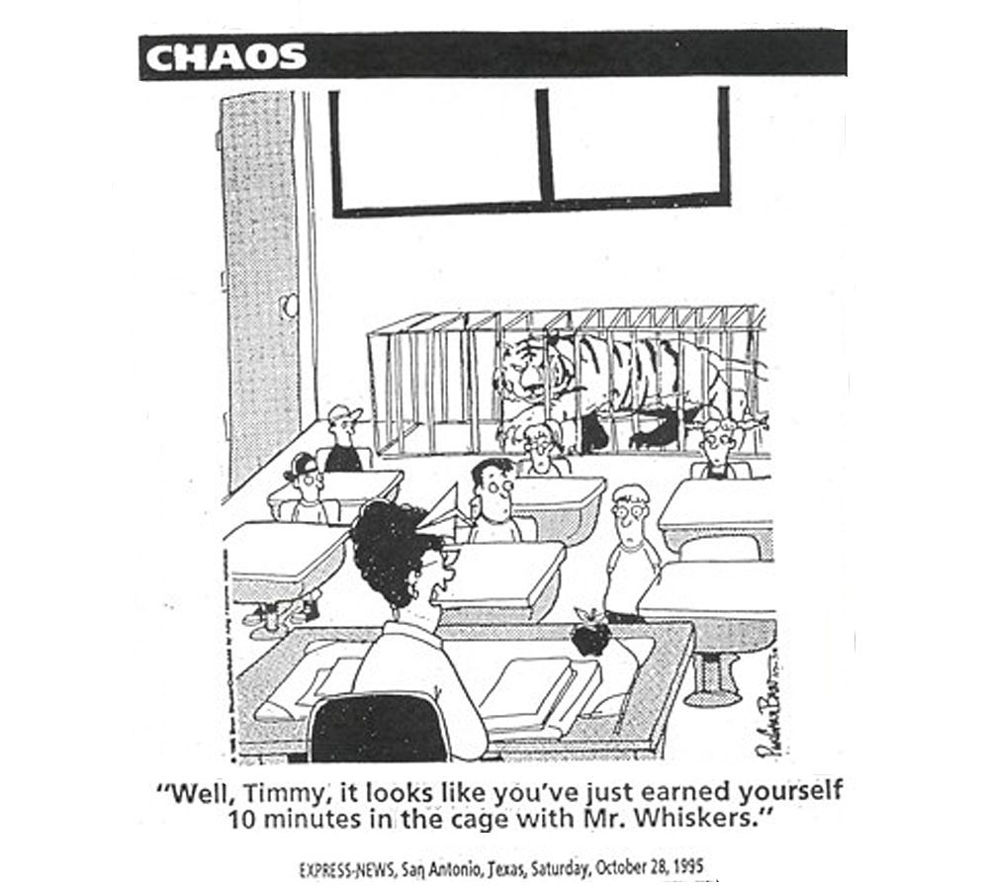
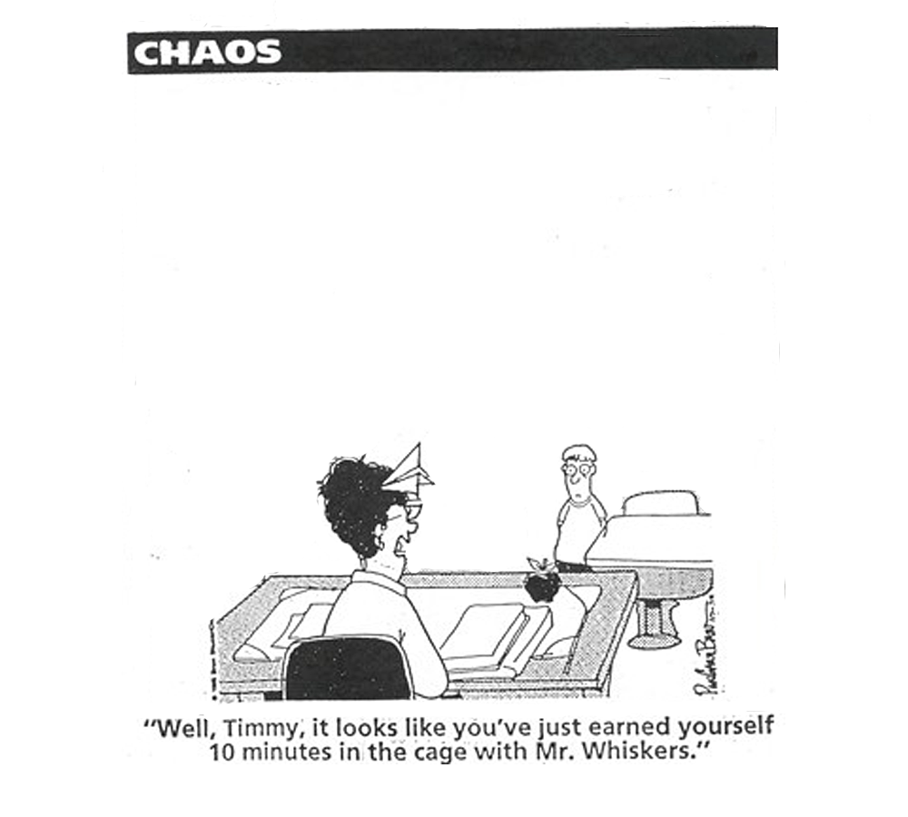

Slide 4
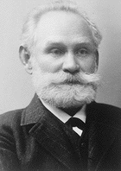

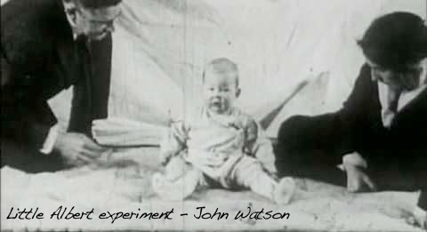
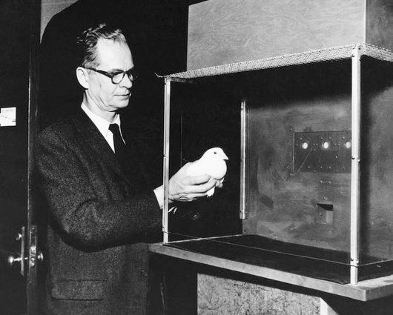
punishment
response
environment
schedules
negative
conditioning
rewards
Behaviourist approaches
external
observable
consequences
systemmatic
stimulus
positive
reinforcement

Slide 5

Behaviourist approaches
7 things games teach us about learning:
Measure progress
Multiple short and long term goals
Reward effort
Rapid, clear feedback
Uncertainty
Increases attentiveness and memory
Interaction with others
Chatfield 2010
digital video games

Slide 6

Limit Setting/Controlling Models
Assertive Discipline – Canter & Canter
Preventive Discipline - Jacob Kounin
Positive Classroom Discipline - Fred Jones

Slide 7
Characteristics of the Models
Students require firm direction from teachers
Learning and behaviour are closely linked
Positive classroom relationships allow teachers to be trusted and respected
Disruptive behaviour occurs in all classrooms. Good teachers use techniques to negate its impact on learning

Slide 8

THE CRISIS CYCLE
Integrated experience
Intervention options
anxiety
External control
Staff actions
reduction
tension
defensive
non-compliant
Internal control
Client actions
acting
out
Notes:
This is just an additional model not covered in the CPI notes and manual. It highlights the difference level of staff involvement or action depending of the position on the crisis cycle. When nonviolent physical intervention is used the clients loses almost total control over their actions - although this can be quickly changed as they calm down and move with either back to a defensive position or on towards tension reduction.

Slide 9
Limit Setting/Controlling Models
Preventive Discipline - Jacob Kounin
Positive Classroom Discipline - Fred Jones
Assertive Discipline – Canter & Canter

Slide 10
Preventive Discipline -
Jacob Kounin
teaching and discipline need to be integrated
interested, stimulated and active learners reduce the risk of disruptive behaviour
planned and coordinated activities within lessons reduce the likelihood of disruptive behaviour
a positive, productive classroom atmosphere or tone is pervasive for all participants

Slide 11
Preventive Discipline -
Jacob Kounin
By correcting misbehaviours in one student, it often influences the behaviour of nearby students
Conversely, noticing positive behaviour in one or a small group of students draws the attention of the others to your expectations
Ripple effect
Withitness
Overlapping
Smoothness
Momentum
Group alerting
Kounin, Jacob S. (1970) Discipline and Group Management in Classrooms. Holt, Rinehart and Winston, Inc.
TEXT from http://wik.ed.uiuc.edu/index.php/Kounin,_Jacob

Slide 12
Preventive Discipline -
Jacob Kounin
Ripple effect
Always be alert to sights and sounds in the classroom.
Arrange the seats so that students are always within eyesight.
Scan the room when working with individuals or small groups of students. When helping an individual make sure that you do not have your back to the rest of the class.
Briefly acknowledge misbehavior at first detection to let the class know that you know. Do not let the misbehaviour escalate before action is taken.
Withitness
Overlapping
Smoothness
Momentum
Group alerting
Kounin, Jacob S. (1970) Discipline and Group Management in Classrooms. Holt, Rinehart and Winston, Inc.
TEXT from http://wik.ed.uiuc.edu/index.php/Kounin,_Jacob

Slide 13
Preventive Discipline -
Jacob Kounin
Ripple effect
Withitness
When instructing one group, the teacher should be able to acknowledge difficulties that students outside of the group may be having so that instruction continues moving.
This also includes distractions from outside the classroom such as notes from the office or students walking through the hallways.
Overlapping
Smoothness
Momentum
Group alerting
Kounin, Jacob S. (1970) Discipline and Group Management in Classrooms. Holt, Rinehart and Winston, Inc.
TEXT from http://wik.ed.uiuc.edu/index.php/Kounin,_Jacob

Slide 14
Preventive Discipline -
Jacob Kounin
Ripple effect
Preplan the lesson so that extraneous matters are realised ahead of time and taken care of. Supplies for the class should always be preorganised before class begins and close to where they will be used.
Once students are doing their work and engaged, do not distract them. Leave them to their work and assist individuals with questions or needs.
Withitness
Overlapping
Smoothness
Momentum
Group alerting
Kounin, Jacob S. (1970) Discipline and Group Management in Classrooms. Holt, Rinehart and Winston, Inc.
TEXT from http://wik.ed.uiuc.edu/index.php/Kounin,_Jacob

Slide 15
Preventive Discipline -
Jacob Kounin
Ripple effect
Keep the lesson moving briskly.
Do not over-dwell on a minor or already understood concept.
Correct students without nagging and quickly return to the lesson.
Have students move from one activity to the next without being forced to wait for each other and each step in the transition.
Withitness
Overlapping
Smoothness
Momentum
Group alerting
Kounin, Jacob S. (1970) Discipline and Group Management in Classrooms. Holt, Rinehart and Winston, Inc.
TEXT from http://wik.ed.uiuc.edu/index.php/Kounin,_Jacob

Slide 16
Preventive Discipline -
Jacob Kounin
Ripple effect
Calling on students at random by asking a question only after scanning the room to make sure students are paying attention.
Raising group interest by interspersing suspense between questions.
Having the entire class respond in unison.
Physically moving around the room and asking students to show what they have done.
Asking one student to respond and looking at others.
Withitness
Overlapping
Smoothness
Momentum
Group alerting
Kounin, Jacob S. (1970) Discipline and Group Management in Classrooms. Holt, Rinehart and Winston, Inc.
TEXT from http://wik.ed.uiuc.edu/index.php/Kounin,_Jacob

Slide 17
Limit Setting/Controlling Models
Preventive Discipline - Jacob Kounin
Positive Classroom Discipline - Fred Jones
Assertive Discipline – Canter & Canter

Slide 18
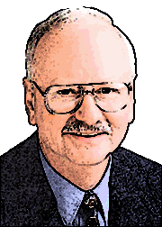
Positive Discipline -
Fred Jones
Classroom management procedures must . . . .
be positive and gentle.
set limits and build cooperation in the absence of coercion
be economical, practical and simple
ultimately reduce the teacher's work load.
offer incentives and encouragement for positive effort
Jones, Fred (2000) Tools for Teaching. Santa Cruz, CA: Frederick Jones and Associates.

Slide 19
Positive Discipline -
Fred Jones
Three different management methods are integrated to form a three-tier approach to discipline management.
‘limit-setting and relationship building form a tier of the management system which we might best describe as the interpersonal-interactive level of management.’
Limit-setting
from http://www.fredjones.com/Positive_Discipline/Discipline_Ch18.html

Slide 20
Positive Discipline -
Fred Jones
Three different management methods are integrated to form a three-tier approach to discipline management.
Limit-setting
make the exchange of positive and negative sanctions prearranged, explicit, concrete, and public.
Incentive systems
from http://www.fredjones.com/Positive_Discipline/Discipline_Ch18.html

Slide 21
Positive Discipline -
Fred Jones
Three different management methods are integrated to form a three-tier approach to discipline management.
Limit-setting
negative sanctions provide a disincentive, or the containment of behaviour when co-operation is lost
Incentive systems
Back-up systems
from http://www.fredjones.com/Positive_Discipline/Discipline_Ch18.html

Slide 22
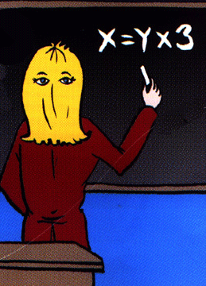
Positive Discipline -
Fred Jones
There are seven steps in limit setting:
Eyes in the back of your head

Slide 23

Positive Discipline -
Fred Jones
There are seven steps in limit setting:
Stop what you are doing and concentrate on the disruption
Eyes in the back of your head
Terminate Instruction

Slide 24
Positive Discipline -
Fred Jones
There are seven steps in limit setting:
Stop what you are doing and concentrate on the disruption
Face the student, make eye contact, and remain calm
Eyes in the back of your head
Terminate Instruction
Turn, look, and say the student’s name

Slide 25
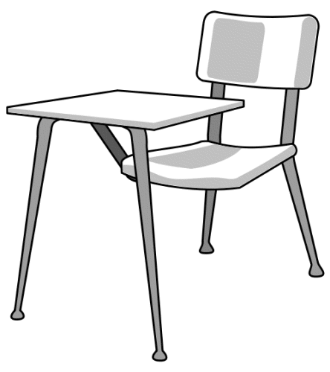

Positive Discipline -
Fred Jones
There are seven steps in limit setting:
Face the student, make eye contact, and remain calm
Eyes in the back of your head
Walk calmly to the front of the student’s desk and avoid comments
Terminate Instruction
Turn, look, and say the student’s name
Walk to the edge of the student’s desk

Slide 26
Positive Discipline -
Fred Jones
There are seven steps in limit setting:
Eyes in the back of your head
Walk calmly to the front of the student’s desk and avoid comments
Demonstrate what is expected
Terminate Instruction
Turn, look, and say the student’s name
Walk to the edge of the student’s desk
Prompt

Slide 27
Positive Discipline -
Fred Jones
There are seven steps in limit setting:
Eyes in the back of your head
Demonstrate what is expected
Lean towards the student
Terminate Instruction
Turn, look, and say the student’s name
Walk to the edge of the student’s desk
Prompt
Palms

Slide 28
Positive Discipline -
Fred Jones
There are seven steps in limit setting:
Eyes in the back of your head
Shift and maintain eye contact to show you are still aware
Lean towards the student
Terminate Instruction
Turn, look, and say the student’s name
Walk to the edge of the student’s desk
Prompt
Palms
Camping out

Slide 29
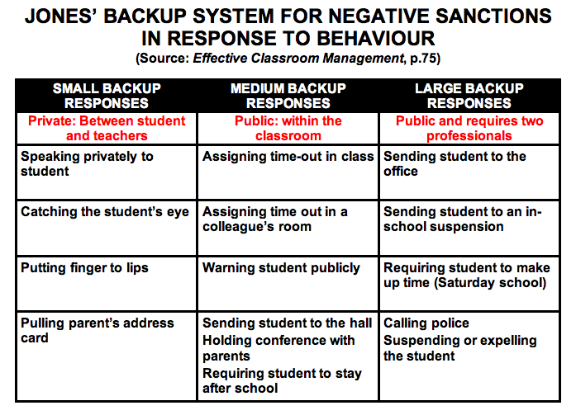
Positive Classroom Discipline -
Fred Jones

Slide 30
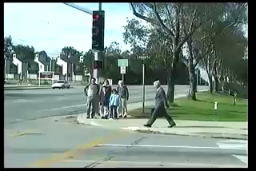
Social cognitive theory
Modelling & control
In social learning theory, Albert Bandura (1977) states behaviour is learned from the environment through the process of observational learning.
Common identity
Vicarious reinforcement
Resulting consequences

Slide 31
Limit Setting/Controlling Models
Preventive Discipline - Jacob Kounin
Positive Classroom Discipline - Fred Jones
Assertive Discipline – Canter & Canter

Slide 32

Assertive Discipline – Canter & Canter
Teachers have the right to determine what is best for your students, and to expect compliance.
No pupil should prevent you from teaching, or keep another student from learning.
Student compliance is imperative in creating and maintaining an effective and efficient learning environment.
To accomplish this goal, teachers must react assertively, as opposed to aggressively or non assertively.

Slide 33
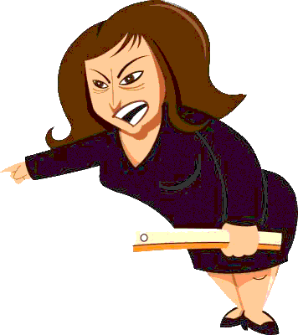
Hostile Teachers
see students as adversaries
use an abrasive, sarcastic and hostile style
focus on the person not on the behaviour
meet their own needs but disregard the needs of the students

Slide 34
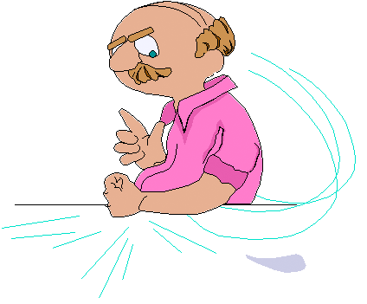
Non-assertive Teachers
ignore or react in desperation
use a passive, inconsistent, timid and non-directive manner
do not communicate their needs to the students
show an uncertainty and fear of the students

Slide 35
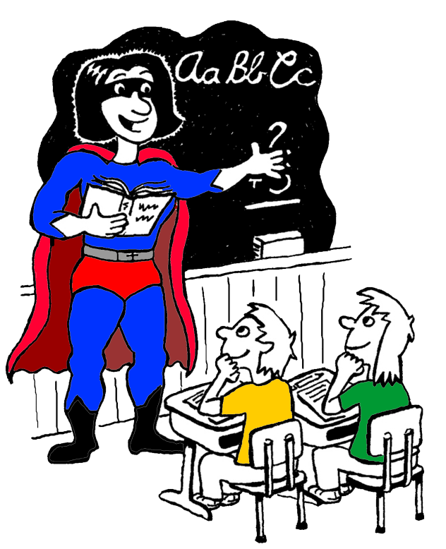
Assertive Teachers
respond confidently, politely and quickly
give firm, clear, concise directions to students
build positive, trusting relationships
are demanding, yet warm in interaction
listen carefully to what their students have to say, and treat everyone fairly (not necessarily equally).

Slide 36
Assertive Discipline – Canter & Canter
features
Clear set of observable, class negotiated rules. Only 3 - 5 max.
For behaviour that breaks the rules a clear, pre-determined set of consequences are laid out.
Focus on positive behaviour with constant reinforcement through comments and recording of compliance.
All students are targeted for both positive recognition and negative consequences when relevant.

Slide 37



CLASS RULES
No talking when the teacher is talking
Stay in your seats
Keep your hands and feet off other people and their property
Follow the instructions given by the teacher
CLASS CONSEQUENCES
1st incident name on board - 1st warning
2nd incident tick - 2nd warning
3rd incident tick - 3rd warning
4th incident tick - stay back after class
5th incident tick - lunch time detention
6th incident tick - leave the class, interview with HT/AP
CLASS RULES
No talking when the teacher is talking
Stay in your seats
Keep your hands and feet off other people and their property
Follow the instructions given by the teacher
CONSEQUENCES
1st name on board - 1st warning
2nd tick - 2nd warning
3rd tick - 3rd warning
4th tick - stay back after class
5th tick - lunch time detention
6th tick - leave the class, interview with HT/ AP

Slide 38


CLASS RULES
No talking when the teacher is talking
Stay in your seats
Keep your hands and feet off other people and their property
Follow the instructions given by the teacher
Caleb



Fabio

Suzie
Jack

Bashir

Shannon
Is it worth it?
Carly



Jess
CONSEQUENCES
1st name on board - 1st warning
2nd tick - 2nd warning
3rd tick - 3rd warning
4th tick - stay back after class
5th tick - lunch time detention
6th tick - leave the class, interview with HT/AP
Ryan




Hassan

Tamika
Lucas

Slide 39

Common pitfalls with Assertive Discipline
Students will not stop behaviours and often will be pushed to get more ticks as a challenge or act of revenge
Ticks are delivered as punishment/consequences not cues/signals
The list of students will be selective rather than inclusive
Ticks are delivered only to certain students in the class
No evidence of a ripple effect
Positive comments to compliant students are not used enough or they are insincere
Little dilemma for students to change
Appropriate positive consequences are not in place

Slide 40
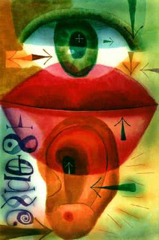
Empathic listening
Reflective or empathic listening skills
Some key principles:
More listening than talking
Trying to understand the feelings contained in what the other is saying, not just the facts or ideas.
Responding with acceptance and empathy, not with indifference, cold objectivity or fake concern.
Restating and clarifying what the other has said, not asking questions or telling what the listener feels, believes or wants.
Responding to what is personal rather than to what is impersonal, distant or abstract.
Sensing of the other's frame of reference while avoiding the temptation to respond from the listener's frame of reference.

Slide 41
Empathic listening script
Reflective or empathic listening skills
A simple script:
What happened?
Can you tell me what happened?
Intro
You feel angry when . . . .
So you are angry/frustrated/disappointed that . . . .
You think it is unfair when . . . .
It seems like you are being picked on . . .
Reflective
listening
So let me see if I have it right. So you are angry that . . . . . . and frustrated with . . . . . . . And when this happens
. . . . . . . . . . . . . . . . . . . . . . . . . . . . . . . . . . . . . . . . . . . . . . . . . . . . . . . . . . . . . . . . . . . . . . . . . . . . . .
Influential
summary
(the issue in your words from what you have understood while listening to the other person)

Slide 42
REFERENCES
Canter, L. & (1976) Assertive discipline – a take charge
Canter, M. approach for today’s educator. Santa Monica, CA
Jones, Fred (2000) Tools for Teaching. Santa Cruz, CA: Frederick Jones and Associates.
Kounin, Jacob S. (1970) Discipline and Group Management in Classrooms. Holt, Rinehart and Winston, Inc.
Bandura, A. (1977) Social Learning Theory. Englewood Cliffs, NJ: Prentice Hall.

Slide 43

CLASS RULES
No talking when the teacher is talking
Stay in your seats
Keep your hands & feet off other people and their property
Follow the instructions given by the teacher

Slide 44
1st incident name on board - 1st warning
2nd incident tick - 2nd warning
3rd incident tick - stay back after class
4th incident tick - lunch time detention
5th incident tick - leave the class, interview with head teacher/AP
CLASS CONSEQUENCES
1st incident name on board - 1st warning
2nd incident tick - 2nd warning
4th incident tick - stay back after class
5th incident tick - lunch time detention
6th incident tick - leave the class, interview with head teacher/AP
3rd incident tick - 3rd warning

